Slide 1
NATURE’S FINEST
SOLAR PROJECT
Presented By
Ramie Klocko & Ophir Bonen

Slide 2
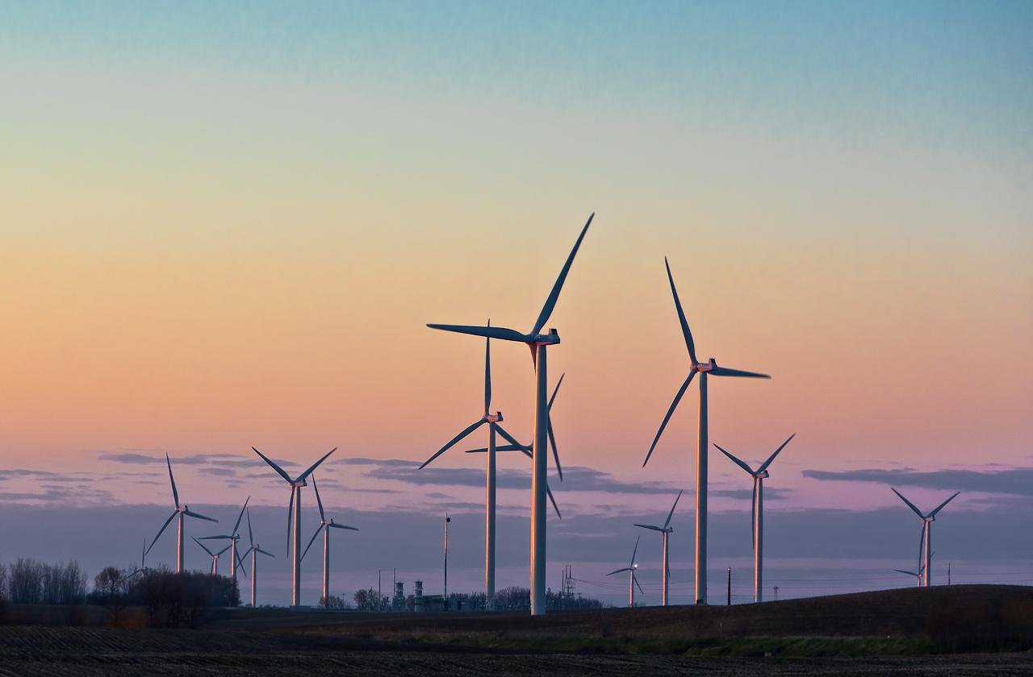
Benefits of Wind & Solar Power at the Garden
Provides clean & renewable energy
Independent Offgrid System
Cost Efficient Energy Production
Durable Hardware
Self-Sufficient & Sustainable

Slide 3
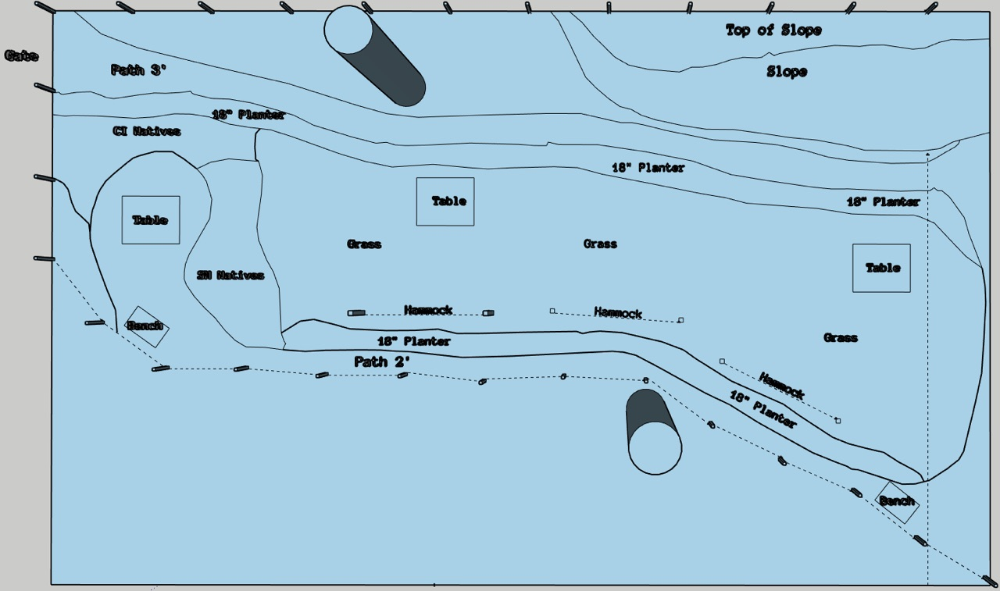
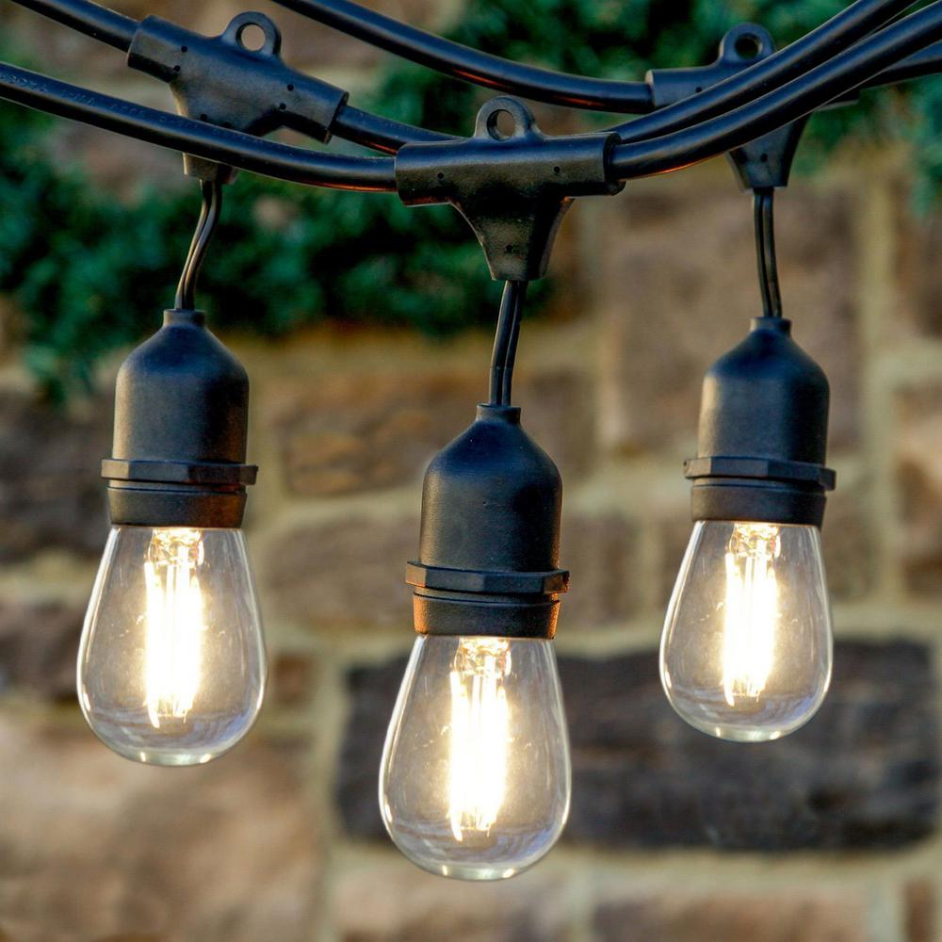

Why we need clean power:
Power supply for Tools
Charging Stations
Wifi Booster
Lighting up the Garden
Future Endeavours
Inspiring others

Slide 4
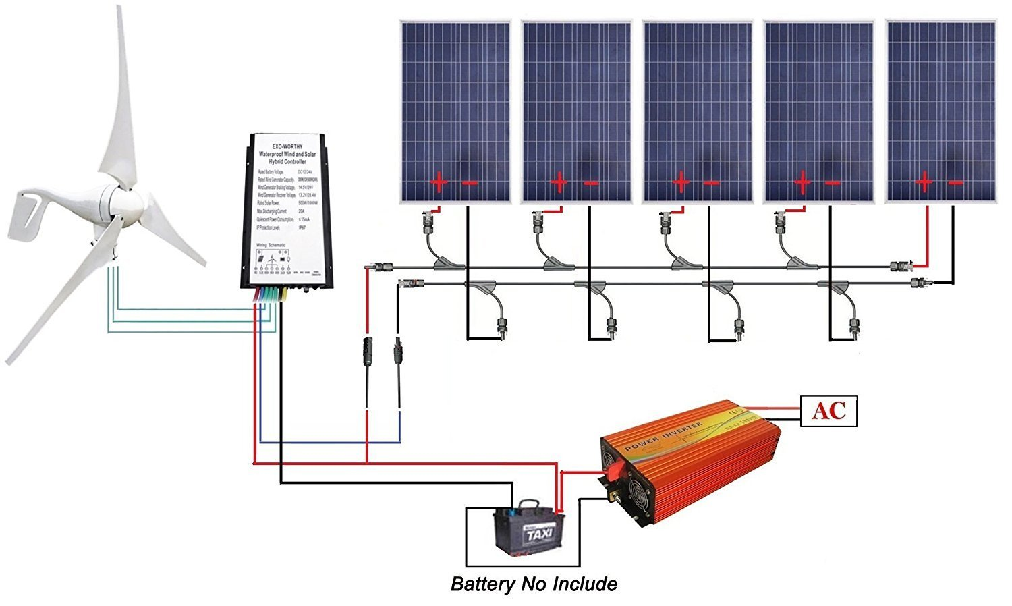

Slide 5
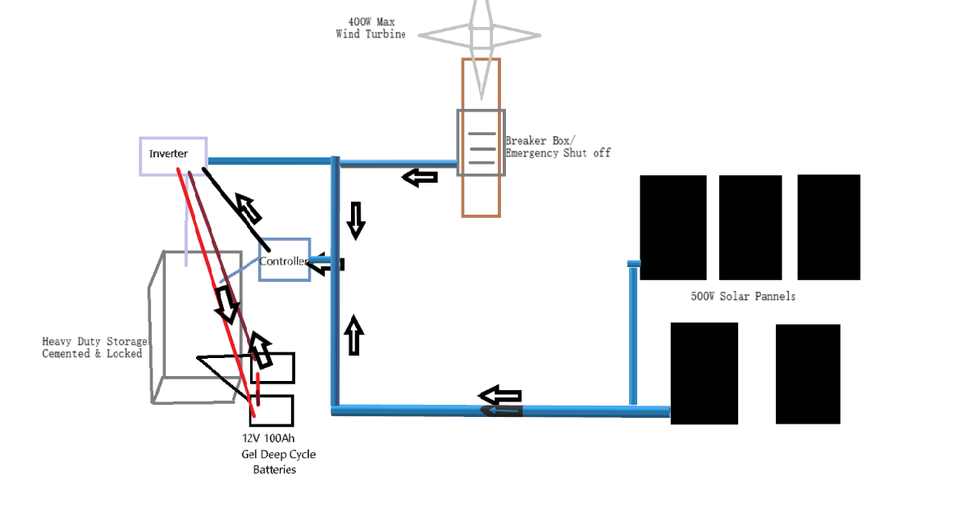

Slide 6
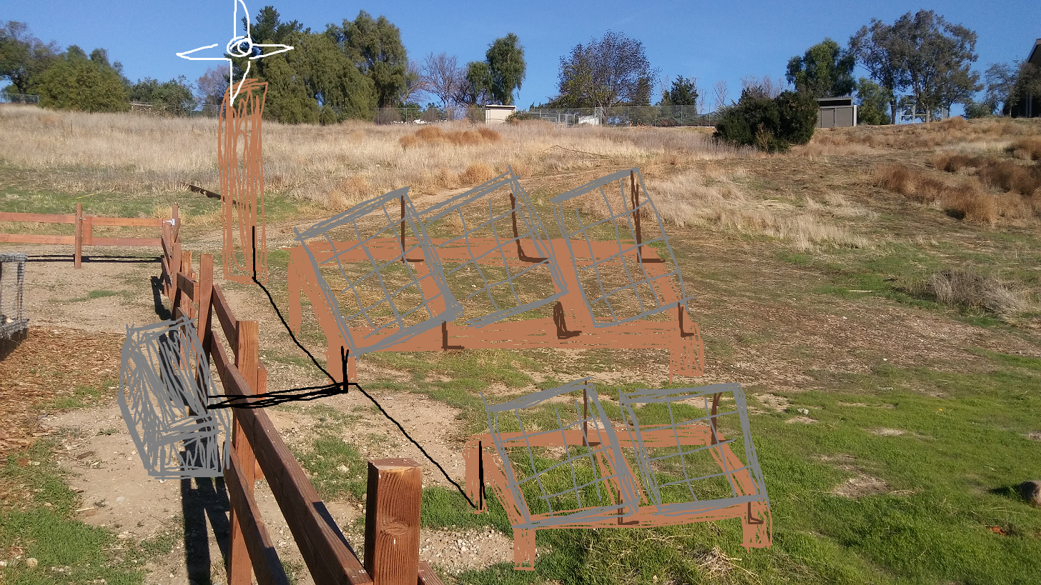

Slide 7
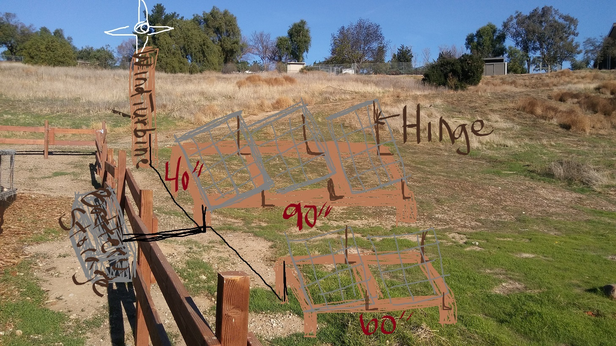

Slide 8
Home Depot:
Amazon
Item | Quantity | Price
900-watt total Panels/Turbine | 1 | $1079
Heavy Duty Storage Box | 1 | $200
Renogy Deep Cycle Pure Gel Batteries | 2 | $660
Total |  | $1939
Tax (8.25%) |  | $160
Total w/Tax |  | $2,099
Item | Quantity | Price
Wood Mount 2’’x6’’x8’ treated | 5 | $50
Wood Posts for Mount 4’’x6’’x8’ | 2 | $40
Post for Turbine 6’’x6’’x8’ | 1 | $27
Cement for posts | 2 | $24
A-F-C grounded breaker | 1 | $40
2-20-amp circuit breaker | 1 | $10
Breaker Box | 1 | $40
PVC Conduit | 7 | $28
Mounts & Screws | 45 | $90
Cables | 2 | $21
Total |  | $370
Tax |  | $30
Total w/Tax |  | $400
Grand Total: $2,499

