Slide 1
Becoming an Advocate: Understanding the Budget and Legislative Process
Friday, June 17, 2022, General Session: 1:00-2:00 PM

Slide 2
Becoming an Advocate: Understanding the Budget and Legislative Process
As the legislature increasingly passes laws impacting academic and professional matters, it is imperative that faculty stay informed on the budget and legislative processes and increase local and statewide advocacy efforts. Presenters will review the budget and legislative processes and discuss ways faculty, especially local academic senate leaders, can engage in advocacy.

Slide 3
Presenters
Cheryl Aschenbach,
ASCCC Vice President
Wendy Brill-Wynkoop,
FACCC President

Slide 4
Law and Regulation
California Education Code
(EDC or Ed Code)
Law
Enacted by the Legislature or budget bill language
Signed by the Governor - no signature implies consent
Often requires regulations and/or funding
Takes an act of the legislature or voter proposition to change
Notes:
Cheryl

Slide 5
Law and Regulation
California Code of Regulations
(CCR Title 5)
Regulation with the strength of Law to implement Ed Code
Title 5 (Education)
Division 6 (California Community Colleges)
Enacted by the CCC Board of Governors
Chapter 6 (Curriculum and Instruction) and the California Community Colleges Curriculum Committee (5C)
Notes:
Wendy
There is Title for CCCs and for CSU, so just keep that on your radar - CCC Title 5 is in Division 6.
Regs are approved by the BoG, but also have to go through the Office of Administrative Law (OAL) before final approval: https://oal.ca.gov/rulemaking_participation/
BoG provides 45-day public comment period, if changes are made in response then there is a 15-day public comment period. After BoG approval, must submit to the OAL within one year. OAL has a review period of no more than 30 working days.
The BoG relies primarily upon the advice and judgment of the 5C in regs on Curriculum and Instruction.

Slide 6
California Community Colleges
Governance System
System Practitioners
Consultation Council
Title 5
California Code of Regulations
Education Code sections, added by AB 1725 (stats. 1988, c. 973) which created the Community College system and set forth the duties of the Board of Governors, including the requirement to establish and carry-out a Consultation Process.
(Ed. Code section 70901(e))
Chancellor’s Office
Board of Governors
Notes:
Wendy
Board of Governors appointed by the governor
6-year terms for most; 2-year terms for the two faculty members, two student members, and one classified professional member
sets policy and provides guidance
Consultation Council
18 representatives from system practitioner groups
chaired by deputy chancellor
provides recommendations to the chancellor and Board of Governors
Chancellor’s Office
chancellor serves as CEO and oversees the system’s executive office
divisions led by vice chancellors
System Practitioners

Slide 7
System Budget Requests
The budget process is a year long process
July
Sept
Jan
May
June
Initiate Process
System Request
Governor’s Budget
May Revise
Final Budget
The CCCCO solicits budget requests from system partners, such as CoFO
Consultation Council makes recommendations on system requests. The BOG approves the System Budget Ask.
The Governor announces the first draft of the budget and the budget advocacy window opens.
The Governor releases the budget revision about mid May. Trailer bill and budget bill language is written and amended.
The Governor and the legislator have until June 15 in the Constitution to have a signed and balanced budget
Notes:
Cheryl
For System budget requests

Slide 8
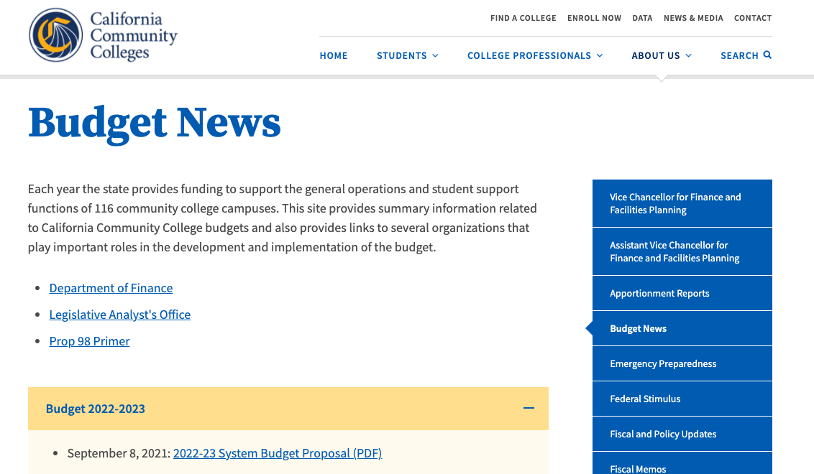
CCC System Budget Requests
Notes:
Cheryl
In addition to the system budget requests, and the system budget asks
Mention - DOF and LAO links as well as the Prop 98 Primer

Slide 9
State Budget Process
New Requests
Release of Governor’s Budget
(January 10)
Budget Trailer Bills Introduced (January-February)
Budget Hearings
LAO Report
(February to June)
Governor’s Revisions
(April and May)
Legislative Actions
(June)
Governor’s Consideration
(June)
Budget Year Begins
(July 1)
Notes:
Wendy
Famous May Revise followed by lots of debate
Budget must be passed by June 15
Chancellor’s office budget information https://www.cccco.edu/About-Us/Chancellors-Office/Divisions/College-Finance-and-Facilities-Planning/Budget-News
Governor’s budget documents available
https://www.ebudget.ca.gov/
Legislative Analyst's office
https://lao.ca.gov/Policy-Areas?areaId=4&category=4
Bill Search for budget bills
https://leginfo.legislature.ca.gov/faces/home.xhtml
Dept of Finance Trailer bills
https://esd.dof.ca.gov/trailer-bill/trailerBill.html

Slide 10
Legislative Budget Committees
Assembly Budget (Ting)
Mark Martin, Principal Consultant
  Sub 2 Education Finance (McCarty)
Senate Budget & Fiscal Review (Skinner)
Christopher Francis, Consultant
  Subcommittee 1 on Education (Laird)
Notes:
Wendy
Information, committee members, email, committee meeting dates, meeting recordings and webinar links, agendas, etc available at links on slide
Assembly/Senate alternate years

Slide 11
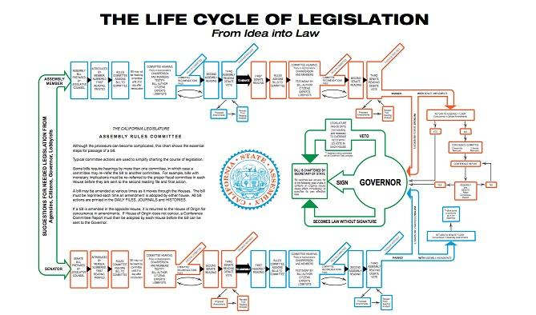
Notes:
Wendy

Slide 12
Sponsor vs. Author
The bill sponsor’s idea is into draft legislative language by the Legislative Council and is introduced to the house of origin by the legislative author.
VS
Sponsor
Author
Individual, advocacy group or organization with bill idea
Elected representative in California Assembly or Senate
Notes:
Cheryl

Slide 13
Bill Life Cycle
Bills originate in the Assembly as house of origin will begin with AB and conversely bills with SB originate in the Senate. If a bill makes it out of the house of origin it will be run through the same process in the second house.
Appropriations Committee
Author
Legislative Bill # AB or SB
Cost of implementation
Feb
April
Mar
Jun
Jan
Sponsor
Policy Committee
Repeat Process in next House
Idea for legislation
Assembly Higher Education
Senate Education
Bills that make it out of the house of origin, move to the next house
Notes:
Wendy

Slide 14
Legislative Calendar
Bills that pass both houses enter the concurrence process to reconcile amendments and then are sent to the Governor’s desk . The bill will then become law (with or without the governor’s signature) or possibly be vetoed and sent back to the legislature with a message from the executive office. The legislature can override the Governor’s veto with a vote of the super majority.
Feb-May
Bill Introduction/Legislative House of Origin
Sept
Concurrence
Committee
Law
Veto
⅔ override
May - Aug
Second Legislative House
October
Governor’s Desk
Notes:
Wendy

Slide 15
How many bills possible in a
two-year session?
Assembly Members and Senators are limited to introducing fifty and forty bills (each, respectively) per two-year session.
Possible 5,600 bills per two year cycle.
2021
2,379 Bills introduced in the state legislature
  203 bills introduced pertinent to CCCs
836 made it to the Governor’s desk
  91 new laws pertinent to CCCs
Notes:
Wendy

Slide 16
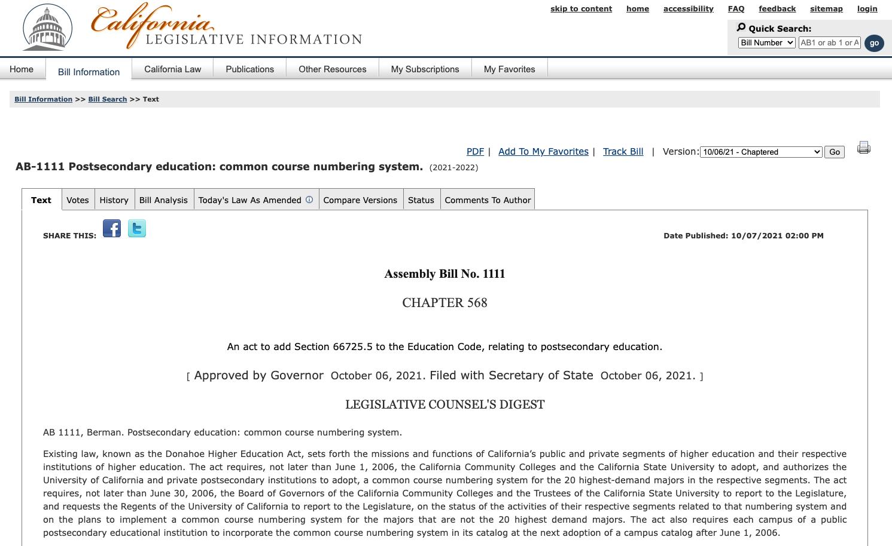
Tracking legislation Through
California Legislative Information Site
Notes:
Cheryl
Create a login and track bills up to 50 - receive email alerts
Track and review amendments, votes, bills analysis, who is in support, status

Slide 17
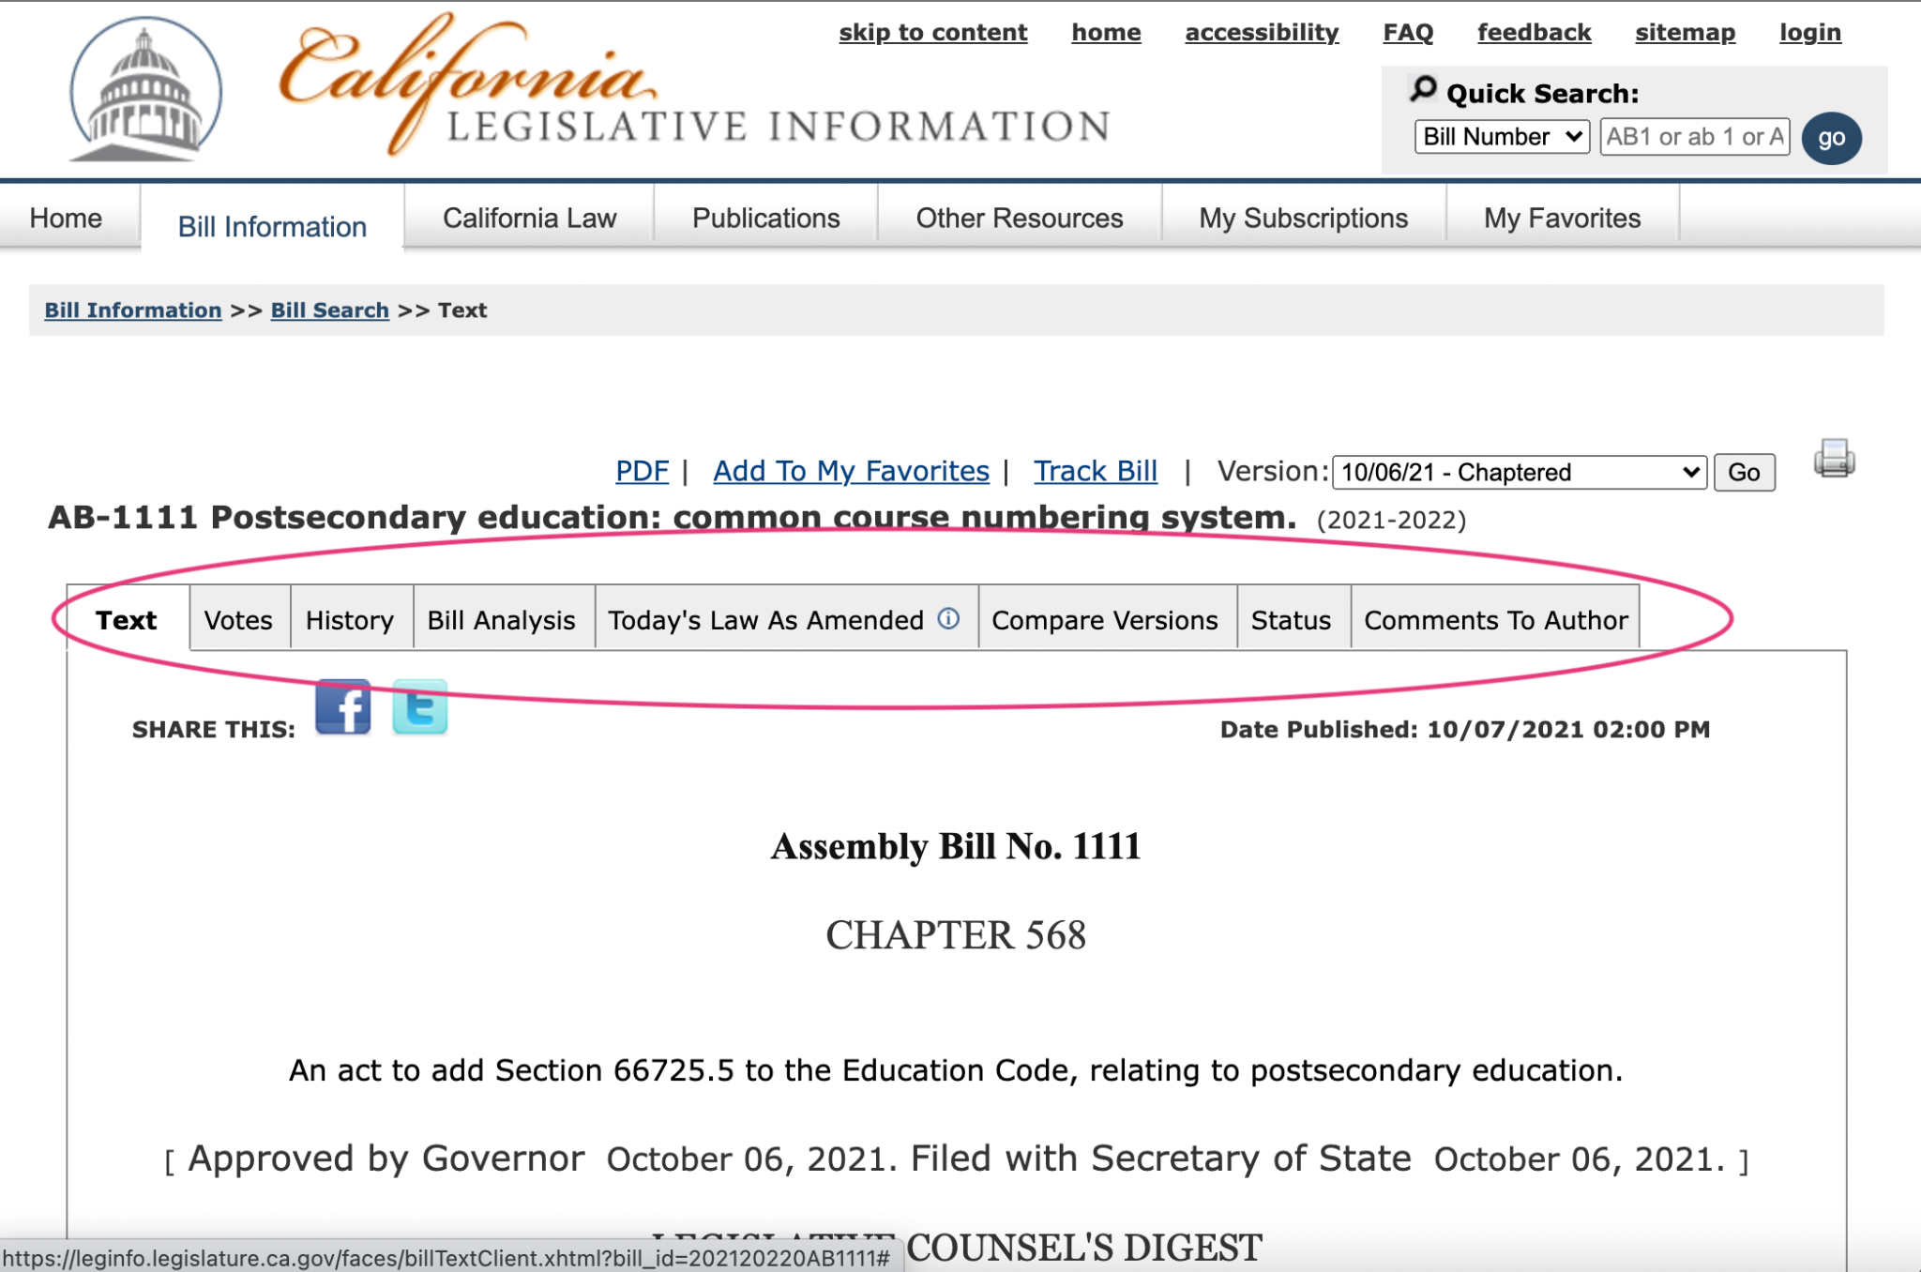
The anatomy of a bill: Example AB 1111
Notes:
Cheryl
Introduced February 18, 2021: AB 1111, as introduced, Berman. Department of Housing and Community Development: regional housing need allocation: low-income community college students.
If one only looks at the August 26 version it appears as though Ed Code is only being changed regarding the date for full implementation and that the rest of it has been approved.

Slide 18
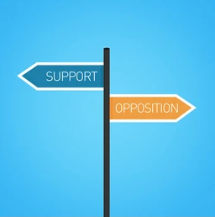
It’s a lot to keep up with…
let System Partners can help.
  ASCCC Legislative Updates
  FACCC Legislative Positions
  CFT Legislative Updates
  CCA Legislation and Political Action
  CCCCO Tracked Legislation
  CCLC Legislative Actions
Notes:
Cheryl

Slide 19
The Advocacy Process
Statewide Legislators
At the local District Level
Statewide System Partners
Notes:
Wendy

Slide 20
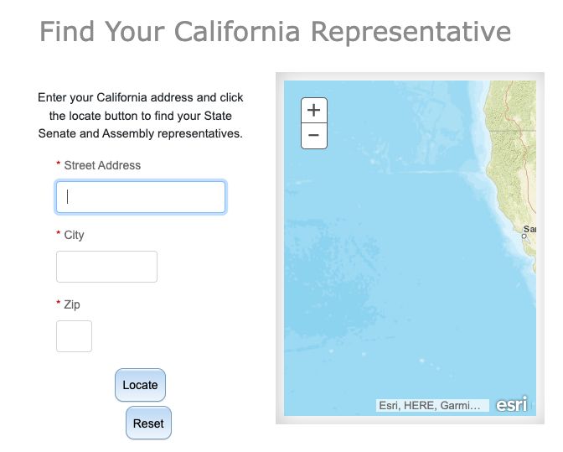
Who are your representatives?
Click here to search by your home address for your legislative representatives.
How about your college district address?
Notes:
Cheryl

Slide 21
Legislature Information and Contacts
Senate
California Senate
Roster of Members of Senate
Streaming of Senate Committee Hearings
Assembly
California Assembly
Roster of Members of the Assembly
Streaming of Assembly Committee Hearings
Notes:
Cheryl
Watch committee hearings
Provide testimony/public comment

Slide 22
Education Policy Committees
Assembly Higher Education (Medina)
  Jeanice Warden-Washington, Chief Consultant
Senate Education (Leyva)
  Olgalilia Ramirez, Consultant
Notes:
Wendy
Information, committee members, email, committee meeting dates, meeting recordings and webinar links, agendas, etc available at links on slide

Slide 23
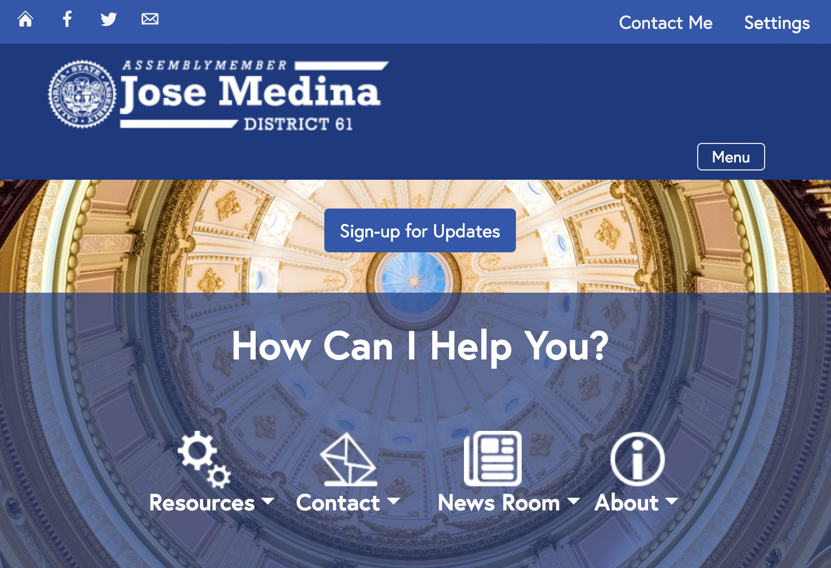
Connecting with your legislator
Notes:
Cheryl
Legislators are people too! Find ways to connect with them before launching into an ask! Read about their interests and legislative proposals.
Locate legislator’s website
Contact legislator
locate district office
Sign up for updates/press releases
Find events
discover what your legislator is interested in
State Capitol / In-district meetings
Zoom meetings

Slide 24
Building a relationship - year round
Research the legislator - start with their website
Know their staff members
Meet on a regular basis
One-on-one meetings
Town hall meetings
District meetings
Special events
Invite to a faculty meeting
Ask how you can assist the legislator
Notes:
Cheryl
It’s good for the first meeting to just talk and not need to ask for something, if possible.
Try to avoid “winning a debate” in the first office visit - you want to leave at or above the same level as you entered. You don’t want the legislator or the staff feeling like they never want to meet with you again - LOL

Slide 25
Statewide advocacy with
system partners
Statewide service with ASCCC, Unions, FACCC
ASCCC Legislative Liaison:
  Who is your local academic senate legislative liaison?
  Check here
Sign up for ASCCC Listservs here:
Join FACCC List-Serve to be aware of faculty advocacy concerns
Become a member of FACCC
Notes:
Cheryl

Slide 26
Department/College/District level
Meet with:
Department Leaders
Faculty Leaders
Academic Senate
College President
Board of Trustees
Students, Student Clubs and Government Leaders
Classified Professionals
Other local representatives
Notes:
Wendy

Slide 27
Resources
California Education Code
California Code of Regulations
California Community Colleges Board of Governors
California Community Colleges Consultation Council
Notes:
Wendy

Slide 28
Advocacy Training and Resources
ASCCC/FACCC Advocacy & Legislative Training Webinar Recording
ASCCC/FACCC on Advocacy and Legislative Training PowerPoint
Why Legislative Advocacy Matters (ASCCC Rostrum, Feb. 2019)
Advocacy at the Local Level: What Your Senate Can Do to Stay Informed and Active (ASCCC Rostrum, Nov. 2013)
Notes:
Wendy

Slide 29
Questions?
Cheryl Aschenbach
ASCCC Vice President
caschenbach@lassencollege.edu
or info@asccc.org
Wendy Brill-Wynkoop
FACCC, President
president@faccc.org

Slide 30
Thank you
for coming!

