Slide 1
Achieving Racial Justice Through Managing the Enrollment and Retention of BIPOC Students: Intrusive Student Services

Slide 2
PRESENTERS
Dr. LaTonya Parker, ASCCC Area D Representative
Tahirah Simpson, San Bernardino Valley College
Robert L Stewart Jr, ASCCC Area C Representative

Slide 3
Breakout Session Description
Despite progress in the number of students receiving postsecondary degrees and certificates, there are persistent gaps in success rates for Black, Indigenous People of Color (BIPOC). Educational outcomes for BIPOC students continue to lag behind their White counterparts. In order to eliminate these racial equity and success gaps, the collective efforts of the entire college must focus on proactive and targeted policies, practices, and programs focused on increasing college access, retention, and completion for students of color. Further, BIPOC students are disproportionately from low-income backgrounds or the first in their family to attend college. Therefore, intrusive student service policies, practices, and programs that also benefit low-income and first-generation students can help alleviate the racial equity gaps in BIPOC student access, retention, and completion. Please join us in a discussion on ways we can target our BIPOC students for success.

Slide 4
Session Outcomes
Understand that there are racial equity gaps concerning the access to, retention within, and successful completion of programs of study in higher education
Understand that equity issues are rooted in Racial Justice
Be able to list and discuss some of the barriers to the achievement of racial justice around enrollment management, retention and success of underrepresented students of color. (Padlet and raised hands)
Discuss strategies and interventions that can be implemented at our colleges in order to manage enrollment, and increase retention and success for our BIPOC students?

Slide 5
What is Racial Justice?
Williams Colleges’ Diversity, Inclusion and Equity statement says that “Racial justice is the systematic fair treatment of people of all races, resulting in equitable opportunities and outcomes for all. Racial justice initiatives address structural and systemic changes to ensure equal access to opportunities, eliminate disparities, and advance racial equity—thus ensuring that all people, regardless of their race, can prosper and reach their full potential”.
https://diversity.williams.edu/racial-justice/

Slide 6
Equity Is Rooted In Racial Justice
Estela M. Bensimon at USC’s Center for Urban Education calls for Racial Equity and Racial Justice in Education
What should colleges be doing:
Acknowledge that equity is rooted in racial justice
https://rossier.usc.edu/racial-equity-in-education-seven-key-points/

Slide 7
What Do We Know?
Although more people are choosing higher education, and in general, higher education has become more diverse, there are still persistent gaps in access, retention and completion for underrepresented minority groups.
This amounts to there being some racial disparities in play when it comes to these gaps in access, retention and completion for underrepresented students of color in higher education.
What can be done to mitigate the equity gaps?

Slide 8
Intrusive Student Services
To narrow the equity gaps, colleges will need proactive and targeted policies and programs that focus specifically on increasing access, retention and completion for students of color.
Is there a cookie-cutter solution? Probably not. However, there are some suggested effective practices out there that can be implemented.
But first, barriers have to be identified.

Slide 9
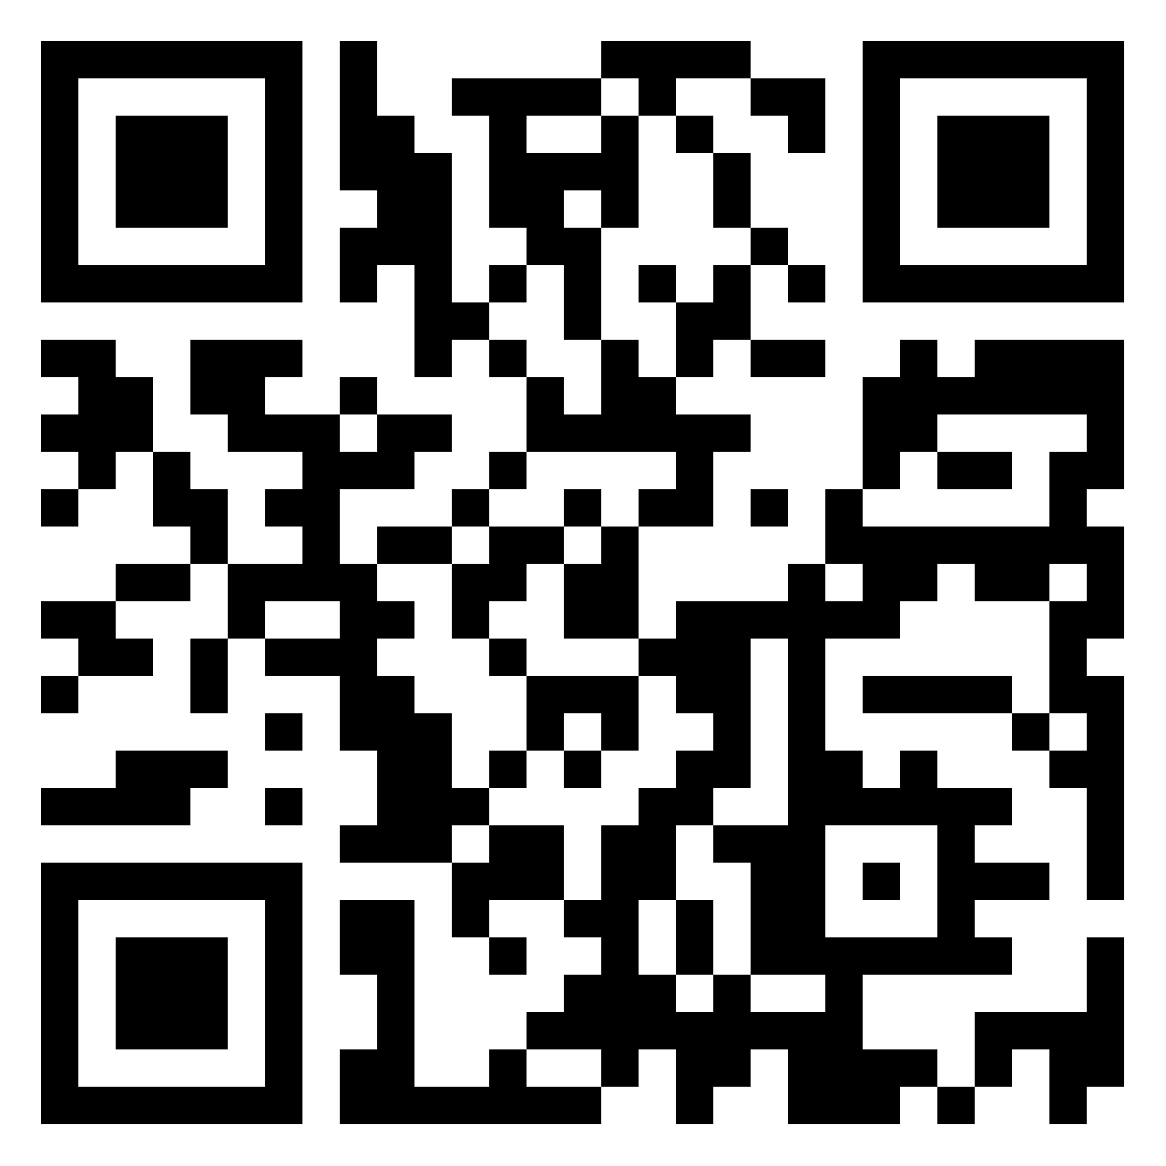
Padlet/Discussion Activity
Please use the padlet link to suggest barriers that you think support racial equity gaps to the access, retention and success of underrepresented students of color?
https://padlet.com/stewarrl/bedlw56n5xqv5csn
For those in person, if you have your phone, table or laptop, please use the padlet link or QR Code. If you do not have access to the internet, please use the provided index cards and go old school.
Please raise your hand to participate in the discussion

Slide 10
What Are Some Intrusive Support Interventions?
Now that we have discussed some potential barriers to racial equity in regards to enrollment management, what are some suggested intrusive interventions for our underrepresented students of color?
Keeping in mind that academic achievement, student retention, and student satisfaction are all essential components of student success.

Slide 11
College Access & Advising Programs for High School Students
Such programs can increase specific college enrollment when specifically aimed at underrepresented students of color
Students come to college sometimes with learning gaps already in place, however, it is still the colleges’ job to address any gaps and provide equitable opportunities for the persistence and success of its students
Therefore, one intervention is to have specific outreach/support programs for feeder campuses

Slide 12
Frequent Required Academic Advising With Comprehensive Wraparound Student Support
Intrusive Academic Advising (Counselor/Instructor)
Mandatory First Year Seminars/Retreats
Mandatory Financial Aid Education/Support
Transportation Assistance
Textbook Support/OER

Slide 13
Holistic Cohort-Based Learning
Has been effective for retaining students of color, increasing grade point average and matriculation, through intensive mentoring, financial support, faculty support and professional development.

Slide 14
High-Impact Practices
High Impact Practices integrate learning within and outside of the classroom and can influence students’ perceptions of their learning
Participation in Learning Communities
Service-Learning Courses
Internships
Capstone Projects

Slide 15
Completion Grants
Many underrepresented students of color are first generation and low income students.
How students are able to address financial barriers are of utmost importance to their retention and completion.
Financial support must not always be contingent on enrollment in a high number of units, or high GPA maintenance

Slide 16
Be Holistic In Approach
We may only think about the student services side of things when thinking about a deficit-solution approach to retention and success
What about the classroom itself? Pillar 4 of Guided Pathways - Ensure Learning
Culturally Responsive Teaching and Learning
Racial Equity Rubrics
Cultural Curriculum Audits
There must be a whole institution approach to enrollment management and mitigating barriers to retention and success of our students of color

Slide 17
Wrap-Up/Questions?

Slide 18
References
https://diversity.williams.edu/racial-justice/
https://rossier.usc.edu/racial-equity-in-education-seven-key-points/
https://richardmedernach.wordpress.com/2018/04/08/intrusive-advising-and-student-success/
https://files.eric.ed.gov/fulltext/EJ1203738.pdf

Slide 19



Thank You!

