Slide 1
Making It Happen: Collaborating with HR To Hire and Retain BIPOC Faculty
Friday, April 8 at 1:30 pm – 2:45 pm

Slide 2
Presenters
Michelle Velasquez Bean, ASCCC Treasurer
Cheryl Aschenbach, ASCCC Secretary
Mohamed Sharif-Idiris, ASCCC Equity and Diversity Action Committee
Leslie Shull, ASCCC Equity and Diversity Action Committee
Gregory Smith, Vice Chancellor of Human Resources, San Diego Community College District

Slide 3
Session Description
Let’s reimagine, interrogate, and disrupt institutional and traditional views of hiring. How do we define the “best qualified” candidate to serve our diverse student communities? How can we collaborate with Human Resources representatives in these key efforts? Join us to discuss creative approaches, principles, and practices, including anonymous screening and cluster hiring, that your campus could use to redefine the hiring processes through an equity-minded framework. We will also discuss how we can engage with each other to understand and support experiences of BIPOC faculty for greater retention. Let’s get at it! Join us as we commit to student success in every part of our employment processes.

Slide 4
Today’s Agenda
Acknowledge “traditional” hiring approach and the local senate's role in modifying the process and practices
Partnering with HR
Cluster hiring
Diversifying hiring committees and increasing student participation
DEIA focused screening, interviewing, and anonymous screening
Retention and support
Exit interview rubric
DEIA competencies and criteria for hiring, evaluation, tenure review
Canvas hiring modules as a resource
Q&A

Slide 5
Current Hiring Processes & Practices
Where are we now?
  Traditional approaches to hiring faculty
Can we make changes?
  Academic senates and faculty hiring processes: CA Ed Code §87360
What is possible and how do we make it happen?
Notes:
Cheryl-5min
NOTE: Use “What is possible and how do we make it happen?” to pass to Greg.
CA Ed Code 87360
https://leginfo.legislature.ca.gov/faces/codes_displaySection.xhtml?lawCode=EDC&sectionNum=87360.
CA Title 5 53024
https://govt.westlaw.com/calregs/Document/I6A6F70B0374E4C078F8396E7AA42C4F4?viewType=FullText&originationContext=documenttoc&transitionType=CategoryPageItem&contextData=(sc.Default)
(a) All screening and selection techniques, including the procedure for developing interview questions, and the selection process as a whole, shall be:
(1) provided to the Chancellor upon request;
(2) designed to ensure that for faculty and administrative positions, meaningful consideration is given to the extent to which applicants demonstrate a sensitivity to and understanding of the diverse academic, socioeconomic, cultural, disability, gender identity, sexual orientation, and ethnic backgrounds of community college students. “Meaningful consideration” means that candidates shall be required to demonstrate sensitivity to diversity in ways relevant to the specific position;
(3) based solely on job-related criteria; and
(4) designed to avoid an adverse impact, as defined in section 53001(a), and monitored by means consistent with this section to detect and address any adverse impact which does occur for any monitored group.
CA Title 5 53001(a)
https://www.law.cornell.edu/regulations/california/5-CCR-Sec-53001
(a) Adverse Impact. "Adverse impact" means that a statistical measure (such as those outlined in the Equal Employment Opportunity Commission's "Uniform Guidelines on Employee Selection Procedures") is applied to the effects of a selection procedure and demonstrates a disproportionate negative impact on any group defined in terms of ethnic group identification, gender, or disability. A disparity identified in a given selection process will not be considered to constitute adverse impact if the numbers involved are too small to permit a meaningful comparison.

Slide 6
Partnering with Your Human Resources Representatives
Review job descriptions and announcements early and regularly
  Avoid rolling over older descriptions
  Start with clearly setting hiring outcomes that align to your college mission and department/area mission statement
  Outcomes should be based on knowledge, skills, and abilities–discuss how to avoid “traditional fit” mindset
Ask HR for robust implicit bias training and cultural humility frameworks
Work with HR on the type of questions that address equity-mindedness throughout the entire screening process
Notes:
Michelle and Greg (3 min)

Slide 7
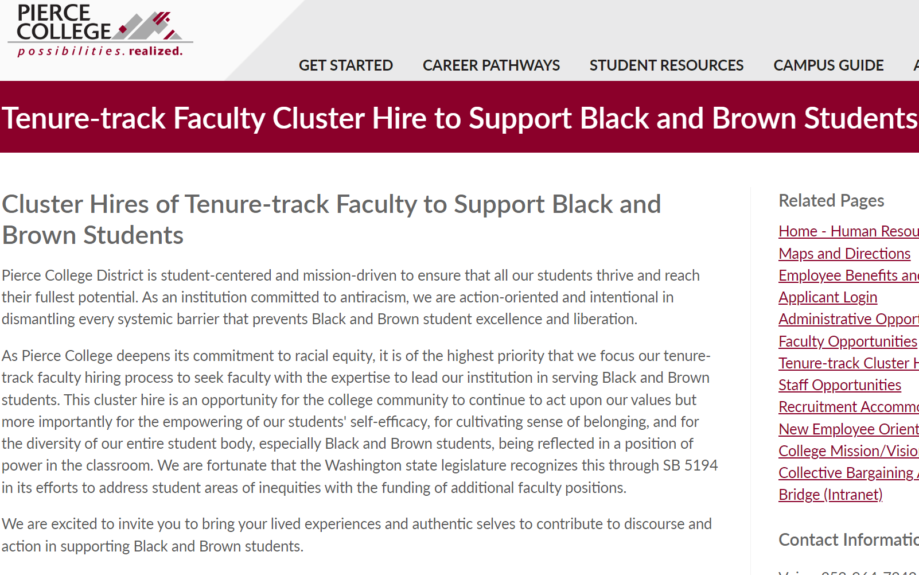
What Is Cluster Hiring?
Cluster hiring is an approach that aims to aggressively onboard diverse candidates by intentionally using strategies to promote success in the hiring of historically underrepresented faculty instructors: Black, Latinx/a/o, Indigenous, Asian Pacific Islander.
Notes:
Michelle (7 min)
San Diego CSU, Pierce College (Washington), and Emory University (Atlanta, GA)along with many other institutions increased their diverse faculty through cluster hiring.
Cluster hiring originally designed to expand interdisciplinary research but research over the past 15 years has shown a positive impact on diversity and institutional climate. (Source Urban Universities for Health)
Educational institutions who make diversity goals explicit and prioritized, who gain support from deans and department heads, and who establish an infrastructure to support interdisciplinary collaborations see an increase in diversity in their faculty. (Source Urban Universities for Health)
Emory University tripled the proportion of faculty hires from underrepresented minority groups in the College of Arts and Sciences within just three years.(Emory)
North Carolina State University increased the percentage of minority faculty from 16 percent to 18 percent, while Fresno State saw a 2 percent increase in Hispanic/Latino faculty, a 3 percent increase in female faculty, and a 20 percent increase in Hispanic/Latino senior administrative leaders. At Purdue University, 54 percent of faculty cluster hires were female. (Source Urban Universities for Health)
Pierce College job announcement: https://careers.insidehighered.com/job/2366803/cluster-hire-of-tenure-track-faculty-to-support-black-and-brown-students
Cluster Hires of Tenure-track Faculty to Support Black and Brown Students
Pierce College District is student-centered and mission-driven to ensure that all our students thrive and reach their fullest potential. As an institution committed to antiracism, we are action-oriented and intentional in dismantling every systemic barrier that prevents Black and Brown student excellence and liberation.
As Pierce College deepens its commitment to racial equity, it is of the highest priority that we focus our tenure-track faculty hiring process to seek faculty with the expertise to lead our institution in serving Black and Brown students. This cluster hire is an opportunity for the college community to continue to act upon our values but more importantly for the empowering of our students' self-efficacy, for cultivating sense of belonging, and for the diversity of our entire student body, especially Black and Brown students, being reflected in a position of power in the classroom. We are fortunate that the Washington state legislature recognizes this through SB 5194 in its efforts to address student areas of inequities with the funding of additional faculty positions.
We are excited to invite you to bring your lived experiences and authentic selves to contribute to discourse and action in supporting Black and Brown students.

Slide 8
Cluster Hiring Recommendations
● Explicitly state diversity as a goal for the cluster hire
● Engage faculty early in the process
● Train search committee members on DEIA
● Ensure student engagement in the process
● Weather leadership changes
● Ensure recruitment efforts are aligned with retention efforts
● Audit and assess cluster results
Notes:
Cluster Hire Rostrum article–spring 2022!
Explicitly state cluster hiring as a primary goal with a focus on looking for scholars who are experienced, invested, and specialized in diversity as their primary focus or expertise.
Engage faculty and employee resource and affinity groups early; employee resource and affinity groups help market and announce the job postings.
Provide robust diversity training to search committee members and ensure diverse committee representation.
Ensure student engagement in the hiring process and inclusion on screening committees.
Ask for support from administrators with a plan for weathering leadership changes.
Ensure recruitment efforts are aligned with retention efforts.
Support new faculty hires with orientation, mentorship, and regular year-long supportive check-ins focused on the needs expressed by faculty of color.
○ Be sure the support of BIPOC campus communities does not become a burden falling solely on the most impacted and underserved groups; this leads to racial battle fatigue. Instead ensure there is an equitable distribution of supporting efforts and a commitment to racial equity from every campus employee.

Slide 9
Diversifying Hiring Committees and Increasing Student Participation
Diversifying Selection Committee Participation
  Issue statement: When screening and interview committees lack diverse perspectives, committees are less likely to prioritize the ability to serve diverse communities as essential for successful job performance
Notes:
Greg (5 min)

Slide 10
Diversifying Hiring Committees and Increasing Student Participation (continued)
Diversifying Selection Committee Participation
  History: Committee appointment rules often require subject matter experts to measure technical knowledge, skills, and abilities (KSA) and an EEO representative for compliance reasons; but do not explicitly call for DEIA-related expertise
Notes:
Greg (5 min)

Slide 11
Diversifying Hiring Committees and Increasing Student Participation Recommendation
Diversifying Selection Committee Participation
  Strategy Recommendation: Revise policies to require committee appointments with equity-focused expertise; train committee members on evaluating candidates’ KSAs through a DEIA framework
Notes:
Greg (5 min)

Slide 12
Diversifying Hiring Committees and Increasing Student Participation Recommendation (continued)
Diversifying Selection Committee Participation
  Desired Outcome: Greater diversity of participants and perspectives redefines “best qualified” to require the ability to engage in a diverse educational community, create equitable outcomes, and contribute to a culture of authentic inclusion.
Notes:
Greg (5 min)

Slide 13
Diversifying Hiring Committees and Increasing Student Participation: Selection Process
Student Participation in Selection Processes
  Issue statement: Screening and interview criteria inadequately assess whether applicants will effectively serve students from diverse communities and diverse student perspectives are missing as committees define “best qualified”
Notes:
Greg (5 min)

Slide 14
Diversifying Hiring Committees and Increasing Student Participation: Selection Process (continued)
Student Participation in Selection Processes
  History: Students are rarely included in selection committees due to the time commitment, unfounded confidentiality concerns, and committees undervaluing their perspective.
Notes:
Greg (5 min)

Slide 15
Diversifying Hiring Committees and Increasing Student Participation: Selection Process Recommendation
Student Participation in Selection Processes
  Strategy Recommendation: Offer formal and informal committee participation opportunities; train committee members on incorporating student perspectives in defining “best qualified”; require committees to prioritize DEIA-related skills in assessing candidates.
Notes:
Greg (5 min)

Slide 16
Diversifying Hiring Committees and Increasing Student Participation: Selection Process Recommendation (continued)
Student Participation in Selection Processes
  Strategy Recommendation
    Formal Participation - full voting member of a committee, attends every meeting, screens and interviews all applicants
    Informal Participation - joins the committee for specific parts of the process to give input
Notes:
Greg (5 min)

Slide 17
Diversifying Hiring Committees and Increasing Student Participation: Selection Process Desired Outcome
Student Participation in Selection Processes
  Desired Outcome: Diverse student participation enables committees to create more robust definitions of “best qualified” directly responsive to the needs and interests of students and hire employees more likely to effectively serve students from diverse communities.
Notes:
Greg (5 min)

Slide 18
DEIA Focused Screening and Interviewing
Historical Context
  Standard hiring processes in our culture were developed primarily in the early 1900s
  Legal, encouraged, and expected discrimination based on race, ethnicity, color, gender, ability status, etc.
Notes:
Greg (5 min)

Slide 19
DEIA Focused Screening and Interviewing (continued)
Historical Context
  Cover letters, resumes, CVs, reference letters, etc. are framed by socioeconomic status markers, access to and inclusion in networks, and biases strongly correlated with cultural identities
Notes:
Greg (5 min)

Slide 20
DEIA Focused Screening and Interviewing Imperative
Imperative for Change
  Where is the success of our diverse communities prioritized in our recruitment and hiring processes?
  What “moment” are we hiring for?
Notes:
Greg (5 min)

Slide 21
DEIA Focused Screening and Interviewing Challenges
Current Challenges
  Name, prior employers, schools attended, and writing style indicate social class, race/ethnicity, gender, etc.
  Based on the unsubstantiated assumption prior experience and education are objective predictors of job-related KSAs and future performance
Notes:
Greg (5 min)

Slide 22
DEIA Focused Screening and Interviewing Challenges (continued)
Current Challenges
  Pervasive positive and negative stereotypes based on superficial socioeconomic indicators biased towards white, cisgender men of western European descent as more naturally inclined to professional work and with greater aptitude in technical fields
Notes:
Greg (5 min)

Slide 23
DEIA Focused Screening and Interviewing Challenges (continued)
Current Challenges
  We do not ask applicants to provide substantive information about how they engage, perform work, and the outcomes they have achieved
  We do not ask applicants for information that helps us predict how successful they will be working with and serving diverse communities
Notes:
Greg (5 min)

Slide 24
DEIA Focused Screening and Interviewing Recommendation
Building a New Selection Process - Application
  A diverse committee defines the desired KSAs within a DEIA frame, prioritizing an understanding of the lived experiences of diverse communities
  Committee defines the essential attributes and behaviors of successful job performance within a diverse environment
Notes:
Greg (5 min)

Slide 25
DEIA Focused Screening and Interviewing Recommendation (continued)
Building a New Selection Process - Application
  Committee drafts open-ended questions based on the essential attributes and behaviors, asking candidates to state outcomes and how they achieved the outcomes
  The initial “application” is the candidate’s responses
Notes:
Greg (5 min)

Slide 26
DEIA Focused Screening and Interviewing Recommendation (continued)
Building a New Selection Process - Application
  Anonymous Screening
    Committee screens responses without seeing personally-identifiable information
    Committee screens responses without seeing socioeconomic and race/gender/etc. indicators from traditional application information
Notes:
Greg (5 min)

Slide 27
DEIA Focused Screening and Interviewing Rubric
Building a New Selection Process - Screening
  Screening Rubric
    Rubrics for scoring candidates’ initial application responses explicitly award points based on successful DEIA-related prior performance and outcomes
Notes:
Greg (5 min)

Slide 28
DEIA Focused Screening and Interviewing Rubric (continued)
Screening Rubric
  0: Application response failed to address the question or demonstrated inadequate preparation and performance
  1: Application response indicated some related experience or preparation, but no clear examples of successful outcomes
Notes:
Greg (5 min)

Slide 29
DEIA Focused Screening and Interviewing Rubric (continued)
Screening Rubric
  2: Application response clearly shows adequate experience or preparation with successful outcomes
  3: Met #2 AND provided successful DEIA-related application of job skills in prior experience
Notes:
Greg (5 min)

Slide 30
DEIA Focused Screening and Interviewing Rubric (continued)
Screening Rubric
  4: Met #2 and #3 AND provided positive contributions to an overall culture of DEIA beyond their individual job performance
Critical change - candidates must show technical KSAs, framed by DEIA engagement and successful behaviors
Notes:
Greg (5 min)

Slide 31
DEIA Focused Screening and Interviewing Recommendation
Building a New Selection Process - Example
  Application Prompt: Describe how you have diversified math curriculum to ensure students from a wide range of cultural communities are represented
Applicant is prompted to respond to three areas: outcomes, process, application
Notes:
Greg (5 min)

Slide 32
DEIA Focused Screening and Interviewing Recommendation
Building a New Selection Process - Example
  Outcomes: Increased retention and success outcomes for students historically experiencing equity gaps by 25% over 3-year period
  Process: Added activities encouraging students to share their identity and experiences, validated their interest in math, tailored assignments to…
Notes:
Greg (5 min)

Slide 33
DEIA Focused Screening and Interviewing Process
Building a New Selection Process - Example
  Process: …allow students to find examples of people from similar backgrounds succeeding in math-related fields, used a variety of visualization and collaborative engagement assignments to promote communication between students, included thought-process activities such as…
Notes:
Greg (5 min)

Slide 34
DEIA Focused Screening and Interviewing Process (continued)
Building a New Selection Process - Example
  Process: …journaling within assignments, and used process-oriented grading instead of right/wrong assessments
Notes:
Greg (5 min)

Slide 35
DEIA Focused Screening and Interviewing Process (continued)
Building a New Selection Process - Example
  Application: As a FT instructor, I would continue to research methods for ensuring students see a wide range of diversity in course materials and implement strategies to reaffirm each student’s interest in math and teach process over right answers to ensure students do not get discouraged
Notes:
Greg (5 min)

Slide 36
DEIA Focused Screening and Interviewing Process (continued)
Building a New Selection Process - Interviews
  Behavioral interview questions are the most effective way to solicit information about how a candidate will perform if we hire them
  Past behavior and performance is the best predictor of future behavior and performance
Notes:
Greg (5 min)

Slide 37
DEIA Focused Screening and Interviewing Process (cont’d)
Building a New Selection Process - Interviews
  Behaviors, not philosophies, matter most in understanding how a candidate will engage with our communities
  Behavioral interview questions can be framed within a specific context, allowing us to ask for technical KSAs and DEIA engagement together
Notes:
Greg (5 min)

Slide 38
DEIA Focused Screening and Interviewing Questions
Behavioral Interview Questions - The Formula
  Helpful lead-in: sets the context and tells the candidate why this questions matters to us
  Open-ended prompt: asks the candidate to tell us about their past behaviors and performance
  Desired behavior: tells the candidate exactly what they need to explain to us
Notes:
Greg (5 min)

Slide 39
DEIA Focused Screening and Interviewing Questions (continued)
Behavioral Interview Questions - The Formula
  Why this formula?
  Helpful lead gives applicants the opportunity to frame their answer in our environment/context
  Drawing on experience eliminates the ‘good interviewee’ bias
  Virtually impossible to “make up” a good answer
Notes:
Greg (5 min)

Slide 40
DEIA Focused Screening and Interviewing Questions (continued)
Behavioral Interview Questions - Example
  Helpful Lead-in: Many of our students are 1st generation college students
  Open-ended prompt: Please describe a time you…
  Desired behavior: Helped someone from a different cultural background understand a new process and achieve their desired outcome
Notes:
Greg (5 min)

Slide 41
DEIA Focused Screening and Interviewing Questions (continued)
Behavioral Interview Questions - Example
  Helpful Lead-in: Many of our students from diverse communities have negative prior experiences with math that leave them discouraged
  Open-ended prompt: Please tell us how you…
  Desired behavior: have engaged students when they appear to be struggling with complex concepts
Notes:
Greg (5 min)

Slide 42
DEIA Focused Screening and Interviewing Summary
Summary
  Diversify committee participation and increase access for students to prioritize DEIA-related engagement and performance
  Anonymous screening based on functional information about actual performance framed by DEIA engagement
Notes:
Greg (5 min)

Slide 43
DEIA Focused Screening and Interviewing Summary (continued)
Summary
  Remove socioeconomic, race, gender, and other identity indicators from application materials to reduce intentional and unintentional biases
  Reframe application prompts through DEIA engagement to set clear expectations for candidates
Notes:
Greg (5 min)

Slide 44
DEIA Focused Screening and Interviewing Summary (continued)
Summary
  Use behavioral interview questions to elicit more substantive answers to assess candidates’ technical KSAs and DEIA engagement
  Use DEIA scoring rubrics to create a structure redefining “most qualified” in a DEIA framework to drive organizational culture change
Notes:
Greg (5 min)

Slide 45
ACHRO DEIA Resources
ACHRO/EEO Strategy Recommendations
http://achroeeo.com/diversity-equity-and-inclusion/
Notes:
Greg (5 min)

Slide 46
Retention and Support for BIPOC Faculty
Intentionality for retaining and supporting BIPOC hires:
New Faculty Programs: ASCCC Canvas Module is there for you!
Affinity Groups
Mentorship: Formal and Informal
ASCCC Caucuses
  Asian Pacific Islander Caucus
  Black Caucus
  Latinx Caucus
  LGBTQIA+ Caucus
  Womxn's Caucus
Notes:
Leslie (4 min)
Programs such as New Faculty Programs, Affinity Groups and Mentorship are needed in order to retain and support BIPOC new hires.
To find out what your campus is doing for new faculty - check with your Senate.

Slide 47

Retention and Support Programs
As a perspective check, there is much value in the social and networking components for diverse new faculty hires.
Budgets need to intentionally include resources for diverse facilitators, mentors, and guest speakers in the training of new hires.
Sample Program Budget Needs:
  Facilitators/Speakers
  Mentees/New Hires
  Mentors
  Materials
  Meals
Notes:
Leslie (3 min)
You’ve filled your pipeline with new hires and now you need to retain them.
Welcome them to your campus, train them and make them feel welcome.
Sample Budget Needs from Los Rios CCD ($50,000 a year):
Facilitators/Speakers: $2500
Mentors: $500
Mentees/ Teachers: $3500
Materials for training run $44 per participant
Meals $3400 total for program
More detail in Mentorship Handbook: https://asccc.org/sites/default/files/publications/asccc_mentorship_handbook_2021.pdf

Slide 48

Who Can Support This Work?
Notes:
Leslie (3 min)
Take the ask for Mentor Programs to your senate
Ask your administration to support. Show them data–see resources in the Mentorship Handbook
Ask HR and EEO committees for data and support
Seek collaborations with local affinity groups and Flex offices/coordinator

Slide 49
DEIA Focused Exit Interviews
Issue Statement: When organizational culture fails to support diversity, equitable outcomes, meaningful inclusion, and wide accessibility, employees from diverse communities are unable to be authentic, contribute fully, and do their best work. In these conditions, diverse employees are more likely to leave
Notes:
Greg (5 min)

Slide 50
DEIA Focused Exit Interviews (continued)
History: Exit interviews are not used consistently throughout the CCC system and rarely ask people for specific feedback on organizational culture towards diversity, equity, inclusion, and accessibility
Notes:
Greg (5 min)

Slide 51
DEIA Focused Exit Interviews (cont’d)
Imperative for Change: Exit interviews can provide perspectives on how the prevailing culture impacts equity, inclusion, and accessibility for employees from diverse communities, attitudes towards diverse student and employee groups, awareness and success of DEIA programs, likelihood of recommending the District to diverse job applicants…
Notes:
Greg (5 min)

Slide 52
DEIA Focused Exit Interviews (cont’d)
Imperative for Change: …impact of current DEIA-related culture on decisions to leave, and other issues impacting employee retention. Through a robust exit interview process, with DEI-focused questions, institutions can gather, analyze, and use data to address specific workplace culture concerns
Notes:
Greg (5 min)

Slide 53
DEIA Focused Exit Interviews Strategy and Considerations
Strategy Proposal: Focus exit interviews on workplace culture and diversity, equity, inclusion, and accessibility.
Key Considerations: Writing effective DEIA-focused questions, process barriers to full participation, analyzing and communicating exit interview findings to stakeholders, and the role of exit interviews in the overall analysis of institutional climate
Notes:
Greg (5 min)

Slide 54
DEIA Focused Exit Interviews Resources
ACHRO DEIA-Focused Exit Interview Template
http://achroeeo.com/wp-content/uploads/2021/04/DEI-Focused-Exit-Interviews-04-08-2021-1.docx
Includes a template for the exit interview form and a report of findings and action plan to address issues identified from the interviews
Notes:
Greg (5 min)

Slide 55
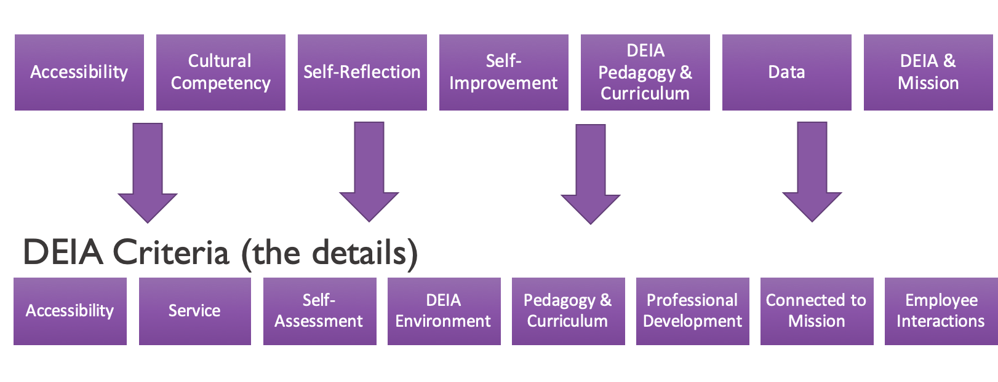
Diversity, Equity, Inclusion, & Accessibility
Competencies and Criteria
Notes:
Cheryl-5 mins (w/ next slide)
https://go.boarddocs.com/ca/cccchan/Board.nsf/files/CCD3QR0802D4/$file/deia-competencies-and-criteria-(updated)-a11y.pdf
Developed collaboratively by a subgroup of the DEIA Implementation Workgroup.
The purpose of establishing DEIA competencies is to define the skills, knowledge, and behaviors that CCC employees must demonstrate to work, teach, and lead in a diverse environment that celebrates and is inclusive of diversity.
Competencies & Criteria intended as a starting point for local dialog; colleges can add or highlight competencies
Establishing a competency framework should include the domains that define each area of skills, knowledge, and behaviors.
A competency framework should be developmental in nature so that employees can demonstrate their growth in skills, knowledge, and behaviors.
Measuring competencies is a more valid evaluation of performance than measurement of innate abilities.

Slide 56
Proposed Regulations:
Hiring and Evaluation & Tenure Review
Product
Include growth-oriented requirements for DEIA in evaluations and tenure review using DEIA competencies and criteria
Dependent on provision of ongoing professional development opportunities for all personnel
Dependent on local negotiation
Process
Introduced at March 21, 2022 Board of Governors Meeting
45-day comment period: March 11-April 25 @ 4:00PM
Likely to undergo revision before May Board of Governors Meeting
Notes:
Cheryl-5mins (w/ prior slide)
Chancellor’s Office Pending Regulatory Actions
https://www.cccco.edu/About-Us/Chancellors-Office/Divisions/General-Counsel/Pending-Regulatory-Action

Slide 57
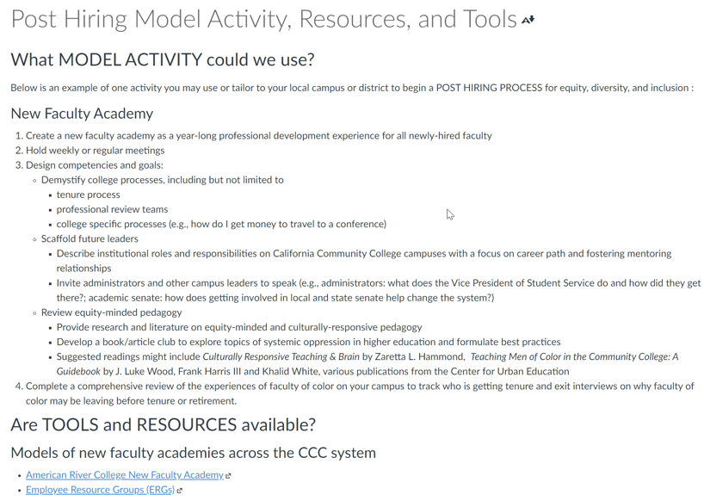
ASCCC Canvas Hiring Modules: Model Activities, Resources, and Tools
Notes:
Michelle (3 min): Canvas link: https://ccconlineed.instructure.com/courses/4924~5733

Slide 58

Q&A
Notes:
All (15 min)

Slide 59

Thank you!
Email questions to info@asccc.org

