Slide 1
Acknowledging Power and Race in Academia with DEIA
Curriculum Equity Planning Tool
Notes:
Welcome:Stephanie

Slide 2
Presenters
Michelle Velasquez Bean, ASCCC Treasurer
Stephanie Curry, ASCCC Area A Representative
Karla Kirk, ASCCC North Representative
Notes:
Stephanie

Slide 3
General Session Description
Curriculum is at the foundation of the work we do in the California Community Colleges; it is our heart work. Come to this session to learn about a tool that can be used at your college to facilitate dialog about power and race in academia. The tool provides promising practices that can be used by faculty, deans, curriculum chairs and committees, chief instructional officers/vice presidents of instruction, and local academic senates to begin conversations on how to redesign practices from working within a traditional Eurocentric model to working within an equity-minded framework. We will discuss and share practices that faculty can use to begin conversations on implementing inclusion, diversity, equity, antiracism, and accessibility (IDEAA) at the classroom level and ways that local curriculum committees and academic senates may support IDEAA work in reviewing credit and noncredit curriculum, course outlines of record, and curriculum documents and processes in the classroom and beyond in culturally responsive ways.
Notes:
Stephanie

Slide 4
Conversation and Dialog Norms
1. Be true to yourself.
2. Commit to learning from each other.
3. Acknowledge each other’s experiences.
4. Trust that others are doing the best they can.
5. Challenge the idea and not the person.
6. Speak your discomfort.
7. Step Up and step back.
Notes:
Michelle
1. Be true to yourself. We want to create an atmosphere for open, honest exchange.
2. Commit to learning from each other. Listen to each other and acknowledge that we all come from different backgrounds, skills, interests, abilities, and values. We realize that it is these very differences that will increase our awareness and understanding through this process.
3. Acknowledge each other’s experiences. We will not devalue people for their experiences, lack of experiences, or difference in interpretation of those experiences.
4. Trust that others are doing the best they can. We will try not to ‘freeze people in time’ but leave space for everyone to learn and change through our interactions with one another.
5. Challenge the idea and not the person. If we wish to challenge something that has been said, we will challenge the idea or the practice referred to, not the individual sharing this idea or practice.
6. Speak your discomfort. If something is bothering you and you are open to sharing, please share it with the group. Often our emotional reactions to this process offer the most valuable learning opportunities.
7. Step Up, Step Back. Be mindful of taking up much more space than others. On the same note, empower yourself to speak up when others are dominating the conversation.
(adapted from the University of Michigan Program on Intergroup Relations, IGR)
We need to build resilience! Remember you may get it wrong and that’s okay–just keep going.
Change is easy when you demand it, but change is hard when you live it!
Expect push back but continue the work.

Slide 5
Many Acronyms - Shared Goal
DEI- Diversity, Equity and Inclusion
DEIA- Diversity, Equity, Inclusion and Accessibility (used by CCCCO)
IDEAA- Inclusion, Diversity, Equity, Antiracism and Accessibility (used by ASCCC)
Notes:
Michelle

Slide 6
Equity and Academic Freedom
•“Academic freedom allows for “invention, scholarship, and creative enterprises that support and enrich humanity. The common good depends upon the free search for truth and its free exposition” (Franke, n.d.). The connection between academic freedom and equity is fundamental. Without the rights of faculty to speak, research, and pursue diverse ideas, equity is not possible. Academic freedom allows faculty to academically challenge racist ideology and structures in the context of their expertise.”
•“By asserting their right to academic freedom and using that right to challenge traditional theories, scholars have been able to create a more diverse and robust exchange of ideas that introduces students to that “multitude of tongues” identified by the Supreme Court. The results of this progress are evident in the proliferation of disciplines such as ethnic studies, gender studies, and LGBTQ studies, among others”
•Protecting the Future of Academic Freedom During a Time of Significant Change, Adopted Fall 2020: https://www.asccc.org/sites/default/files/Academic_Freedom_F20.pdf
•Academic Freedom and Equity, Rostrum article November 2020: https://asccc.org/content/academic-freedom-and-equity
Notes:
Karla
Academic Freedom and Equity | ASCCC (for reference)

Slide 7
Acknowledging Power and Race: The Why
We need to come with INTENTIONALITY–to dig deeper and go beyond compliance
IMPACT is acknowledging
  the baseline–we have minimum requirements for serving our diverse students
  we need to start somewhere–with no shame or blame
  sustainable practice is cultivating cultural humility–self-reflection and accountability
Why do we discuss race and race neutrality?
  social constructs–color blindness does not acknowledge racial inequities
  systemic barriers—we need to disrupt the systems that creates barriers
What does the social justice journey entail?
  the struggle is part of the path
  the work requires intentionality to level the playing field
  we all win when we have equity
Notes:
Michelle
racism is not a thing of the past; it’s dangerous to think so, as there are still significant impacts of racism
remember we are speaking of collective action and impacts; not individual intention (that’s an equity detour when we try to blame individuals instead of address the impact of the behavior)
we need to actively and intentionally address race-neutrality in policy and procedures that actually uphold status quo, dominant power in decision-making
who did the development of those policies and procedures rely on primarily? it may be difficult to hear–we evolve as a society in ways that we may not be comfortable with–but that is the journey!
Race and races are social and political constructs, categories that society invents and manipulates when convenient. (https://neaedjustice.org/social-justice-issues/racial-justice/seven-harmful-racial-discourse-practices-to-avoid/; http://www.miller3group.com/Articles/What_Does_It_Really_Mean.pdf)

Slide 8
DEI Leadership as Heart Work
DEI work is hard work and heart work
Need to build relationships
Create intentional space and time for relationships and trust
Need to have the conversations in order to move the work
May encounter frustrations but keep moving forward
Notes:
Michelle and Stephanie
Building relationships- Intentional space for relationships and trust.
Focus on leadership and supporting curricular conversations.

Slide 9
What ASCCC Says about IDEAA in Curriculum
9.01 F21 Adding Culturally Responsive Curriculum, Equity Mindedness and Anti-Racism to Course Outline of Record (COR) Requirements in Title 5
9.05 S21 Developing an Anti-Racism, Diversity, Equity, and Inclusion Curriculum Audit Process
Anti-Racism in Education Paper (Fall 2020)
Recommendation #5 Enact culturally responsive curricular redesign within disciplines, courses, and programs and with curriculum committees.
Notes:
Stephanie

Slide 10
5C: Collective work on DEI and Curriculum
As colleges design curricula to meet the needs of our diverse student populations, it is recommended that colleges address innovative ways to approach curricular design and the curricular impacts on student success as an opportunity to eliminate equity gaps. The California Community College Curriculum Committee (5C) recommends framing dialogue and decision-making for reimagining curriculum through an equity lens using the following principles:
Principle 1: Commitment to curricular diversity, culturally responsive content, and anti-racism
Principle 2: Commitment to change policies to remove systemic barriers to student success and equity
Principle 3: Commitment to building system resiliency
Notes:
Stephanie

Slide 11
Introducing: DEI in Curriculum Model Principles and Practices
The intention of the DEI in Curriculum Principles and Practices chart is to focus on acknowledging the inequities of historically marginalized racial and ethnic groups (Black, Indigenous, Latinx/a/o, Asian Pacific Islander).
Provide a tool and support structure to have conversations at your campus on looking at current practices and supporting analysis and change.
The tool is not exhaustive, it provides multiple topics but is designed to be expanded as need to support local questions or concerns.
While acknowledgement of intersectional identities is important and valued, the aim of designing the chart was not necessarily addressing accessibility tools, as the California Virtual Campus and Accessibility Center have robust training and support for inclusion and accessibility requirements.
Notes:
Stephanie

Slide 12
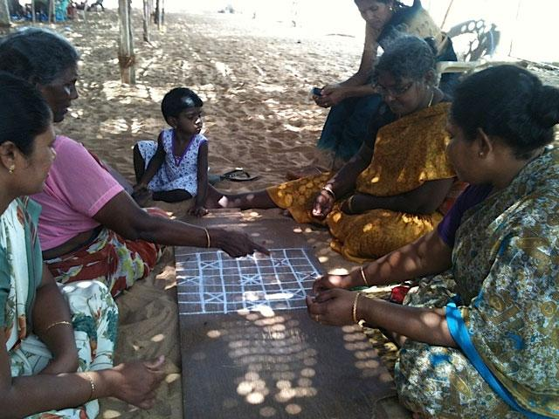
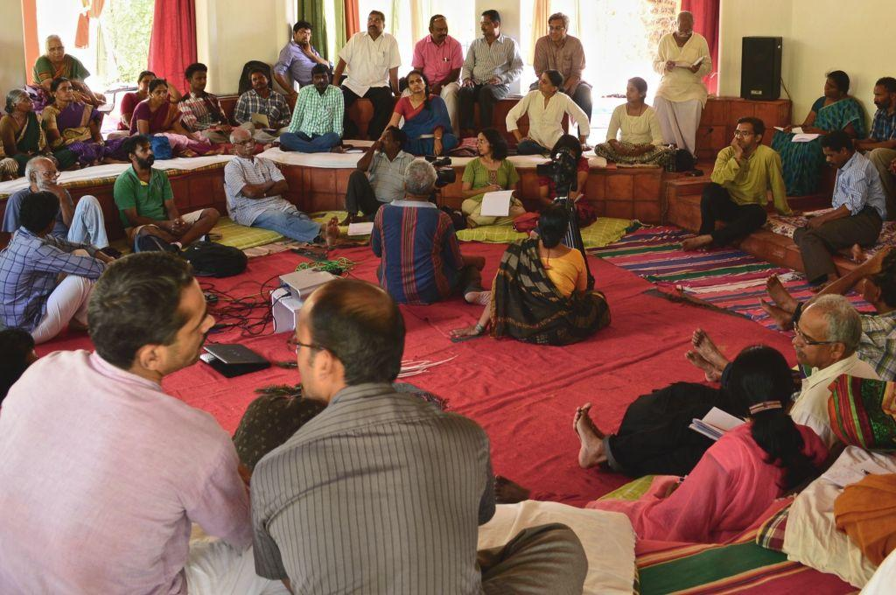
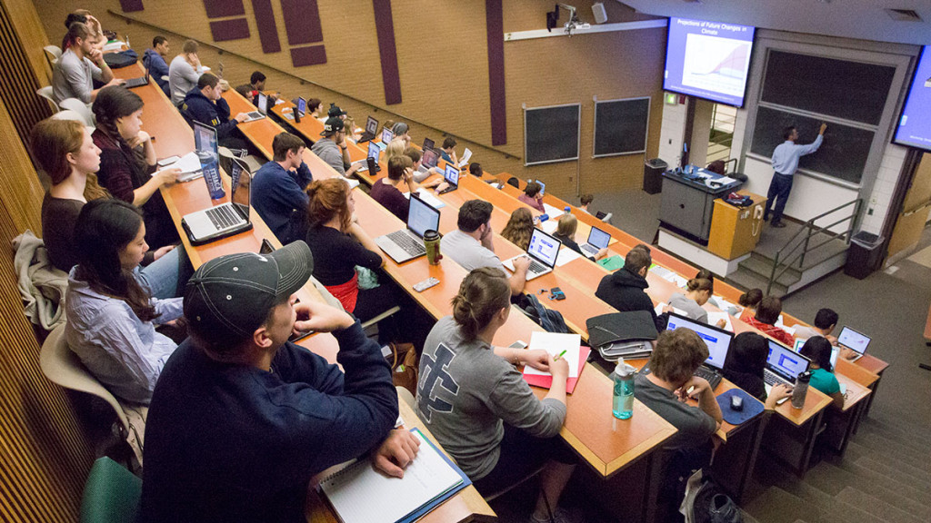
Acknowledging and Identifying Eurocentric Processes
Notes:
Karla
(page 6 of tool: classroom experiences)

Slide 13
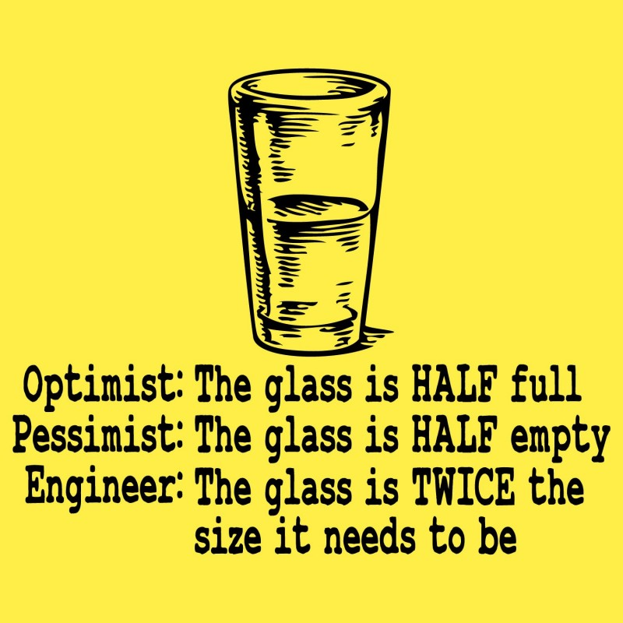
Equity Minded Frameworks
Notes:
Karla: Framing why DEI? Growth centered opposed to punitive concerns.
Keeping inclusive, diverse and equitable educational experience for our students at the heart of our work.

Slide 14
Models and Practices for the Classroom
Engaging with the third column:
All faculty have the opportunity to engage in conversations about equity-minded practices within the context of their disciplinary expertise.
This column provides promising practices that faculty can begin implementing at the classroom level.
Classroom level and curricular practices may include but are not limited to those listed in the chart.
Notes:
Michelle

Slide 15
Models and Practices in Curriculum Process and Policy
Engaging with the fourth column:
Curriculum committees and academic senates have the opportunity to engage in equity-minded review processes of curriculum.
This column shows ways that local curriculum committees and academic senates may support equity work in reviewing credit and noncredit curriculum, course outlines of record, and curriculum documents and processes in culturally responsive ways.
Notes:
Michelle
Again, just suggestions to begin your courageous conversations
These promising practices are not exhaustive nor limited to those on the chart.
Create and discuss what works for your campus.
The focus and aim should be open-mindedness with disrupting traditional mindsets and embracing diversity of thought and critical inquiry in processes and policies for credit and noncredit.

Slide 16
Areas identified in the tool…your college can locally add more
Textbooks
Student-facing documents
Role of discipline faculty
Course syllabus
Classroom assignments/assessments
DEI in all disciplines
Ethnic Studies as a discipline
Siloed programs and services
Your college can add more!
Notes:
Michelle

Slide 17
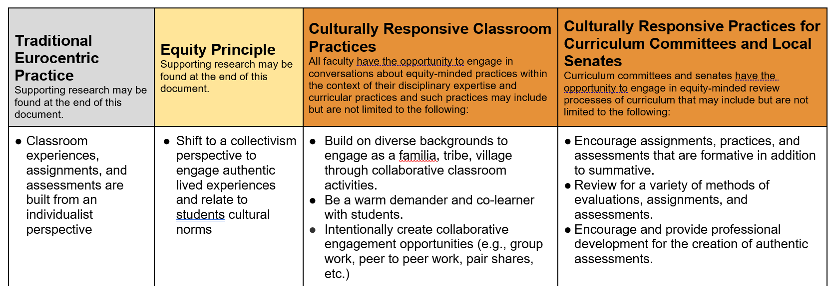
Let’s walk through one of the sections
Notes:
All/Michelle
Traditional Eurocentric Practice: Classroom experiences, assignments, and assessments are built from an individualist perspective
Equity Principle: Shift to a collectivism perspective to engage authentic lived experiences and relate to students cultural norms
Culturally Responsive Classroom Practice:
● Build on diverse backgrounds to engage as a familia, tribe, village through collaborative classroom activities.
● Be a warm demander and co-learner with students.
● Intentionally create collaborative engagement opportunities (e.g., group work, peer to peer work, pair shares, etc.)
Culturally Responsive Practices for Curriculum Committees and Local Senates:
● Encourage assignments, practices, and assessments that are formative in addition to summative.
● Review for a variety of methods of evaluations, assignments, and assessments.
● Encourage and provide professional development for the creation of authentic assessments.

Slide 18
How to use the tool locally
Not going to solve all problems but tool to move the conversations and work forward.
Take this back to your local senates and curriculum committees (also will be highlighted at the CI 2022 in July)
Meant to be shared in cross functional conversations (faculty, staff, students and administrators)
Dedicate time to working through the tool, conversations may need to take multiple meetings. There is no shortcut to this work.
Be willing to be vulnerable and uncomfortable in these conversations.
Notes:
Stephanie

Slide 19
From Discussion to Action
Once you have the conversations be willing to act on your findings.
Don’t just talk about changing policies, processes and procedures, do it.
It does not have to be perfect before you make changes (first pancake).
Discuss how you are going to evaluate the change and its impact.
Share what is working and what is not with fellow colleagues, let’s learn together.
Notes:
Stephanie

Slide 20
Next Steps
1) 3.02 S22 Adopt the DEI in Curriculum Model Principles and Practices Framework
Resolved, That the Academic Senate for California Community Colleges adopts the DEI In Curriculum Model Principles and Practices and encourages local senates to use the model to review their curriculum practices; and
Resolved, That the Academic Senate for California Community Colleges works with system partners to support the implementation of the DEI in Curriculum Model Principles and Practices through collaborative professional learning. DEI in Curriculum Model Principles and Practices
2) Joint memo to field from Chancellor’s Office, ASCCC, CCCIO and SSCCC and professional development support for implementation
Notes:
Stephanie

Slide 21
Support and Resources
Email: info@asccc.org
Local Senate Visit on using DEI in Curriculum Model Policies and Practices or Generally on IDEAA in Curriculum
OERI has also developed a curricular audit tool to share with your colleagues (link is in the DEI Model Polices and Practices Document)
Notes:
Stephanie

Slide 22

QUESTIONS?
Notes:
All

