Slide 1

Institutional Self-Evaluation Report (ISER) Training
March 19, 2021
Dr. Catherine Webb
Vice President, ACCJC

Slide 2

Welcome!
Introductions & Zoom Norms
Topics for Today:
  Recent Changes at ACCJC
  Accreditation Purposes & Processes
  Interpreting the Standards for Self-Evaluation
  Developing the ISER: Tips & Resources
  After the ISER: What to Expect

Slide 3
Learning Outcomes for Today’s Training
Understand the ISER in context of the accreditation process
Engage in the self-evaluation process as an opportunity to document and establish goals for continuous improvement
Interpret Standards and apply them to your College/District policies and practices
Write a concise, clear, and evidence-based ISER

Slide 4
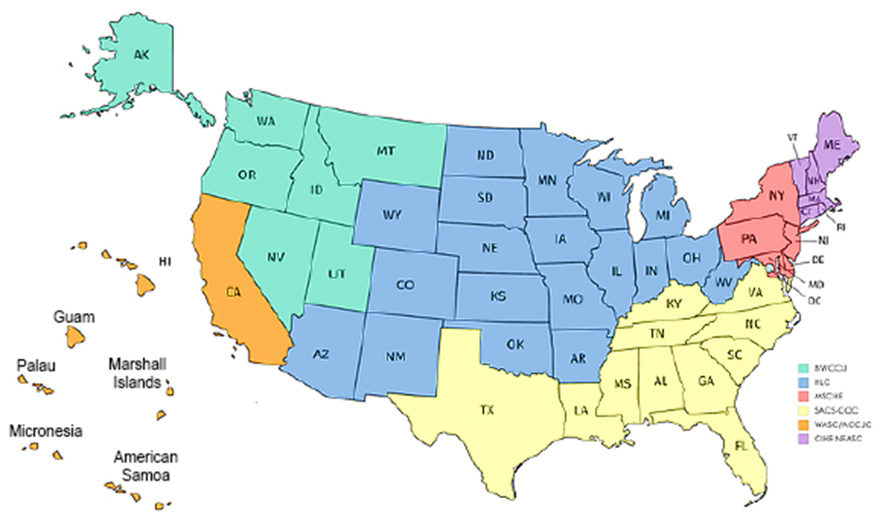
Context for Accreditation
Notes:
National context:
7 institutional accreditors in the US, in 6 regions – including the Pacific Islands in the Western Region
All 7 agencies demonstrate a commitment to peer review that does not exist outside the US
Uses academic inquiry and ongoing reflection to inform effective practices for improvement
Form of self-regulation that recognizes the unique communities and missions that exist in US institutions of Higher Ed
Allows each institution to be evaluated by practitioners, rather than a ministry of education or other government officials
Evaluations for each institution involve similar expectations for quality, but is conducted through the lens of the institution’s own individual mission, vision, and values
Note that ACCJC:
Is the only institutional accreditor that solely works with two-year institutions
Accredits institutions in Hawaii and the Pacific Islands, as well as those in California

Slide 5
ACCJC’s Mission & Values
Mission Statement
The Accrediting Commission for Community and Junior Colleges supports its member institutions to advance educational quality and student learning and achievement. This collaboration fosters institutional excellence and continuous improvement through innovation, self-analysis, peer review, and application of standards.
Core Values
Integrity | Quality Assurance | Institutional Improvement
Peer Review | Student Learning & Achievement | Collegiality

Slide 6
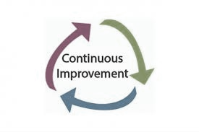
ACCJC Mission & Values in Action
VP Portfolio Model
Improved Trainings and Resources
Streamlined Reporting Processes
  Substantive Change
  Annual Report and Annual Fiscal Report
  Midterm Report
Formative/Summative Approach
Standards Review (Upcoming)

Slide 7

Why is accreditation important?
Notes:
A few reasons emerging from Moorpark College attendees:
Establishes expectations for academic quality
Ensures a degree of uniformity for articulation and transfer
Employers often ask students to have degrees/certificates from accredited institutions
Accredited status is required in order to disperse federal financial aid through Title IV
Provides structure for reflecting on and improving college processes, as well as for celebrating successes

Slide 8
The Accreditation Evaluation Process
#ACCREDITATION365
Self-Reflection
(ISER)
Peer Review
(Visit)
Affirmation
(ACCJC Action)
Ongoing Commitment to Improvement & Educational Excellence
Notes:
Think of the self-evaluation as the beginning of the process, rather than the end (in the training Catherine used the metaphor of a pre-test on the first day of class, rather than the final exam)
The team will read your ISER to validate your self-assessment and help you identify areas of strength or improvement that you may not have seen – they do not consider past ISERs, and know that you have resolved any recommendations/requirements from your last cycle
Underneath the review is an ongoing commitment to improvement & educational excellence that informs your everyday work and ongoing alignment with Standards throughout the 7-year cycle.

Slide 9
Good Practices for the Self-Evaluation Process
Suggested process outlined in Guide to Institutional Self-Evaluation
Plan backward, and build in “slip time”
Include as many people as possible in some aspect of the reflection
Keep the mission in mind
Discuss the Standard, gather the evidence, then write
Communicate, communicate, communicate
Engage the District staff early and begin with the Functional Map
Collaborate with sister colleges as (and if) appropriate
Notes:
A few suggestions, based on observation and experience from ACCJC staff
The process in the Guide seems relatively straightforward, but there are many moving parts to track. Mapping out the timeline will help. Be sure to give yourself time for the “unforeseen circumstances” that often come up.
Also consider building in lots of mechanisms for participation and dialogue – look for ways to include people the process. There can be lots of ways to participate in the process that don’t involve writing an ISER narrative, and your reflection will be stronger if it includes diverse perspectives.

Slide 10
Interpreting
Accreditation Standards
Notes:
Accreditation work begins with Accreditation Standards. Generally speaking, remember that they are:
Statements of good practice, expectations for institutional quality
Developed and revised through a peer process, informed by national context
Broadly written (ACCJC membership includes different kinds of institutions, and all institutions should be able to see themselves reflected in the standards)
Application/implementation varies by college, through the lens of the mission

Slide 11
Key Concepts Woven Throughout
Focus on achieving institutional mission
Integrity and honesty in institutional policies and actions
Focus on student outcomes
  Student achievement: Completion of meaningful educational goals
  Student learning: Attainment of demonstrable knowledge and skills
Metrics and evidence used to assess institutional quality
Ongoing internal quality assurance practices
Continuous improvement for high performance

Slide 12
Four Main Standards
Standard I
Standard II
Standard III
Standard IV
Mission, Academic Quality & Institutional Effectiveness, & Integrity
Student Learning Programs & Services
Resources
Leadership & Governance

Slide 13
Divided into Fourteen Sections
Standard I
Standard II
Standard III
Standard IV
Mission
Instructional Programs
Human Resources
Decision-Making Roles & Responsibilities
Physical Resources
Chief Executive Officer
Assuring Academic Quality & Institutional Effectiveness
Library & Learning Support Services
Technology Resources
Governing Board
Institutional Integrity
Student Support Services
Financial Resources
Multi-College Systems or Districts
Notes:
Particularly in areas where it seems as though individual Standards overlap, the outline structure can help you focus on the core meaning and intent, as shown in the example on the next slides.

Slide 14
Interpreting Individual Standards
Step 1: Use highest-level Standard as your lens
Standard II.A.1
Standard II = Student Learning Programs and Services
Standard II.A = Instructional Programs
Notes:
In this example, you know before you read the Standard that it will focus primarily on Instructional Programs, because it is in IIA. This is an overly simple example for demonstration purposes – it’s even more useful in Standards that touch on multiple areas.

Slide 15
Interpreting Individual Standards
Step 2: Isolate the basic components of each sentence
(i.e., subject, verb, direct object)
Standard II.A.1:
All instructional programs, regardless of location or means of delivery, including distance education and correspondence education, are offered in fields of study consistent with the institution’s mission, are appropriate to higher education, and culminate in student attainment of identified student learning outcomes, and achievement of degrees, certificates, employment, or transfer to other higher education programs.
Notes:
Focusing on the basic elements of each sentence can help you quickly find the core focus of the Standard.

Slide 16

Breakout Activity - Interpreting Standards
  Goals:
  Discuss varying perspectives on specific standards
  Identify differences between similar or related standards
  Identify evidence that demonstrates alignment
  Begin to norm interpretations and expectations
Notes:
Breakout groups discussed the Standards and questions on the ISER Activity Handout.

Slide 17
Breakout Activity - Interpreting Standards
  Join your breakout room
  Read through the example standard for your group
  Discuss your interpretation and accompanying questions
  Determine 1-2 sources of good evidence
  Be prepared to share out and discuss with the full group
Notes:
Breakout groups discussed the Standards and questions on the ISER Activity Handout.

Slide 18
Report-Out: Group 1
  I.A.2 (Mission):
  The institution uses data to determine how effectively it is accomplishing its mission, and whether the mission directs institutional priorities in meeting the educational needs of students.
  I.B.4 (Assuring Academic Quality and Institutional Effectiveness):
  The institution uses assessment data and organizes its institutional processes to support student learning and student achievement.
  I.B.5 (Assuring Academic Quality and Institutional Effectiveness):
  The institution assesses accomplishment of its mission through program review and evaluation of goals and objectives, student learning outcomes, and student achievement. Quantitative and qualitative data are disaggregated for analysis by program type and mode of delivery.

Slide 19
Report-Out: Group 2
  I.B.2 (Assuring Academic Quality and Institutional Effectiveness):
  The institution defines and assesses student learning outcomes for all instructional programs and student and learning support services.
  II.A.3 (Instructional Programs):
  The institution identifies and regularly assesses learning outcomes for courses, programs, certificates and degrees using established institutional procedures. The institution has officially approved and current course outlines that include student learning outcomes. In every class section students receive a course syllabus that includes learning outcomes from the institution’s officially approved course outline.
  II.C.2 (Student Support Services):
  The institution identifies and assesses learning support outcomes for its student population and provides appropriate student support services and programs to achieve those outcomes. The institution uses assessment data to continuously improve student support programs and services.

Slide 20
Report-Out: Group 3
I.A.3 (Mission):
The institution’s programs and services are aligned with its mission. The mission guides institutional decision-making, planning, and resource allocation and informs institutional goals for student learning and achievement.
I.B.9 (Assuring Academic Quality and Institutional Effectiveness):
The institution engages in continuous, broad based, systematic evaluation and planning. The institution integrates program review, planning, and resource allocation into a comprehensive process that leads to accomplishment of its mission and improvement of institutional effectiveness and academic quality. Institutional planning addresses short- and long-range needs for educational programs and services for human, physical, technology, and financial resources.
III.D.2 (Fiscal Resources):
The institution’s mission and goals are the foundation for financial planning, and financial planning is integrated with and supports all institutional planning. The institution has policies and procedures to ensure sound financial practices and financial stability. Appropriate financial information is disseminated throughout the institution in a timely manner.

Slide 21
Report-Out: Group 4
  I.C.5 (Institutional Integrity):
  The institution regularly reviews institutional policies, procedures, and publications to assure integrity in all representations of its mission, programs, and services.
  IV.A.7 (Decision-Making Roles & Processes):
  Leadership roles and the institution’s governance and decision-making policies, procedures, and processes are regularly evaluated to assure their integrity and effectiveness. The institution widely communicates the results of these evaluations and uses them as the basis for improvement.
  IV.C.7 (Governing Board):
  The governing board acts in a manner consistent with its policies and bylaws. The board regularly assesses its policies and bylaws for their effectiveness in fulfilling the college/district/system mission and revises them as necessary.

Slide 22
Report Out: Group 5
  IV.D.2 (Multi-college Districts/Systems):
  The district/system CEO clearly delineates, documents, and communicates the operational responsibilities and functions of the district/system from those of the colleges and consistently adheres to this delineation in practice. The district/system CEO ensures that the colleges receive effective and adequate district/system provided services to support the colleges in achieving their missions. Where a district/system has responsibility for resources, allocation of resources, and planning, it is evaluated against the Standards, and its performance is reflected in the accredited status of the institution.
  IV.D.7 (Multi-college Districts/Systems):
  The district/system CEO regularly evaluates district/system and college role delineations, governance and decision-making processes to assure their integrity and effectiveness in assisting the colleges in meeting educational goals for student achievement and learning. The district/system widely communicates the results of these evaluations and uses them as the basis for improvement.

Slide 23
Reflection
  What are your key takeaways from the activity?
  What did you find particularly helpful?
  How can this approach inform your ISER process?
  What challenges do you anticipate as you get started?

Slide 24
Developing the Report &
Preparing for Peer Review

Slide 25
Good Practices for Approaching the Report
Discuss the Standard, gather the evidence, then write
All required elements are embedded in the ISER template
Keep the narrative clear, direct, and focused – use active voice
Use introductory sections to set the context and tone
Consider assigning ERs 1-5 & Commission Policies to related teams
Format as an electronic document from the start
“Freeze” evidence from websites in a PDF or screenshot
Notes:
Good practices based on observation and experience of ACCJC staff and other seasoned ALOs.
Once you’ve assembled the evidence, you’re ready to begin writing. Follow the template (this can be downloaded from the ACCJC website) and refer to the Guide to Institutional Self-Evaluation, Improvement, and Peer-Review often.
Keep the narrative clear, focused, and direct – thinking of this as a technical report that uses business-style writing will help keep the document from being lengthy. You can also find suggested page lengths for each section in the Guide to Institutional Self-Evaluation, Improvement, and Peer-Review (see Table 2, on p. 26).

Slide 26
Good Practices for Evidence
Gather your evidence before you begin writing
More evidence is not necessarily better
Provide representative samples showing results of institutional processes
Use evidence to demonstrate how processes/cycles are institutionalized
Call out relevant sections of large documents (highlights, excerpts, etc.)
Compare your evidence with suggestions in Guide to Self-Evaluation

Slide 27
Structure for Analysis of Standards
Evidence of Meeting the Standard
  Indicates WHAT specific evidence demonstrates alignment with the Standard
Analysis and Evaluation
  Analyzes HOW the evidence demonstrates alignment with the Standard
  Evaluates the effectiveness of the policy, procedure, or practice, if needed
Conclusions on Standard X (at the end of each section)
  Summarizes the effectiveness of the College’s efforts towards Standard
  Includes improvements the College determines would strengthen alignment
Notes:
This is a suggested approach to these sections. See the Guide for more information, as well. However you choose to approach the structure of the institutional analysis, be consistent throughout your report as this will aid your reader.

Slide 28
Improvement Plans and the QFE
Self-Identified Improvement Plans (i.e., planning agendas)
  Plans to strengthen alignment to specific standards
  Connected to specific Standards or across multiple Standards
  Report on progress in the Midterm Report
Quality Focus Essay (QFE)
  Long-term plans to improve student learning and achievement
  Include measurable and achievable outcomes, timeline, responsible parties
  Report on results in the Midterm Report

Slide 29
Helpful Resources on the ACCJC Website
ACCJC Standards and Eligibility Requirements
Guide to Institutional Self Evaluation, Improvement, and Peer Review
ISER Template
ACCJC Policies
“Policy Checklist” (used by peer review teams; see Guide, Appendix C)
Distance Education Protocol

Slide 30
Heads Up: Federal-Level Changes to DE
From the US Dept of Education (ED), Sept 2020
  Final rule re: Distance Education & Innovation under the Higher Education Act
  Changes:
  Modifies definitions for distance education and correspondence education
  Defines substantive interaction
  Other issues, e.g., direct assessment, academic attendance, clock hour
  ACCJC policy revisions in progress
  Public Comment and 2nd Read, June 2021

Slide 31

Next Steps
Now: ISER development
Spring 2023: Team ISER Review
Core Inquiries Identified
Fall 2023: Focused Site Visit
Core Inquiries Validated
Jan 2024: Commission decision
Throughout the process: ACCJC training & support
Notes:
A bit more about the Formative/Summative Review:
Formative (Team ISER Review)
Your team will review your ISER a semester prior to the site visit.
They will verify and validate compliance with as many Standards as possible from the ISER and evidence provided, meaning that they will not require verification during the onsite visit.
They will also identify areas where they have questions or need more information before they can verify/validate. These could be areas where they need more clarity, or they may be areas connected to potential recommendations or commendations. These areas become the “core inquiries” that will be the focus of the onsite visit. The team will send these core inquiries to the college prior to the visit.
Summative (Focused Site Visit)
A small group from the original team comes to the college for a Focused Site Visit to validate and verify the remaining Standards, through the lens of the core inquiries. ACCJC anticipates that the Focused Site Visit can be shorter than a traditional comprehensive visit.
After the Focused Site Visit, the team finalizes its team report.

Slide 32
Reviewing the College and ACCJC Core Values
Peer: collegial, co-equal, collaborative, cordial
Appreciative inquiry:
  trust their expertise
  lead with assumptions of success
  apply your expertise in search of best practices
  identify alignment with Standards
  identify areas for improvement or compliance
Triangulate consistency of information
Trust. Respect. Appreciate.
Excerpted from Team Training materials, Spring 2021
Notes:
This slide is excerpted from the most recent team training presentation, and is included here to emphasize ACCJC’s expectations for the peer review processes.

Slide 33
Checking in: Final Thoughts
What questions remain? Comments to share?

Slide 34
Thank you!!

